Slide 1
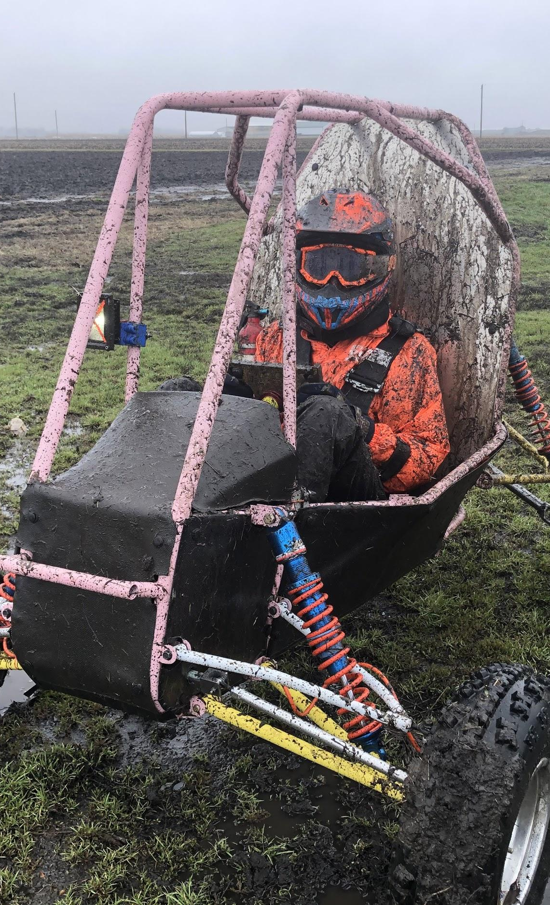

ME 199
03/23/2020

Slide 2
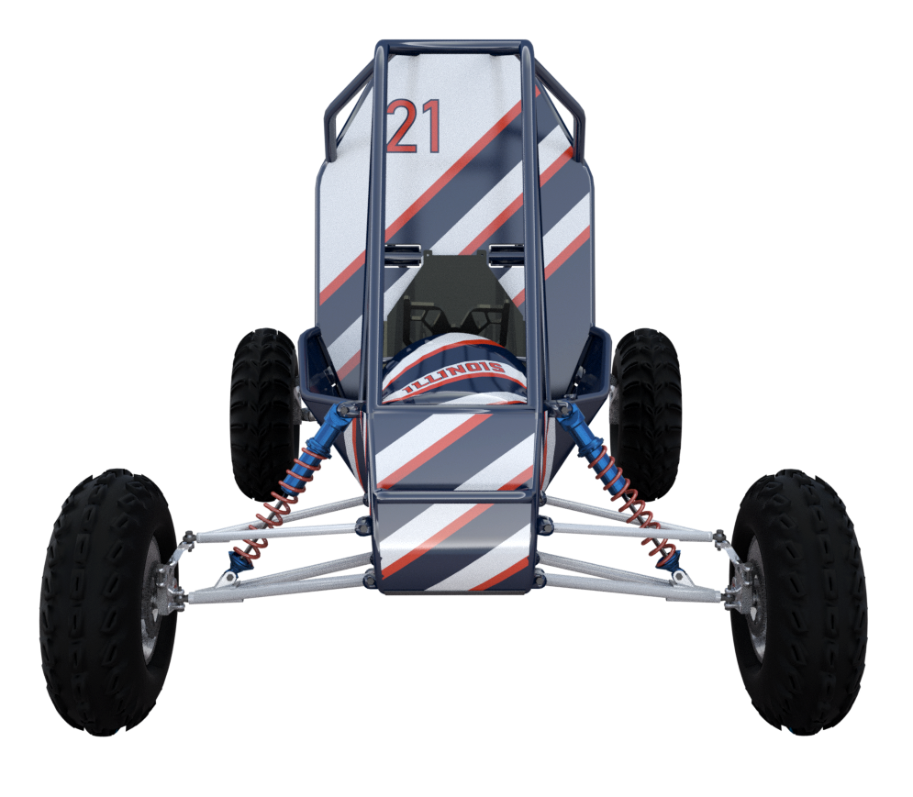
Overview
Post Spring Break Structure
How we’re doing projects
How we’re doing attendance
Sub-Team Meetings
Competitions
How SAE is running it
What we’re doing
Wiki Changes
Sub-Team Updates

Slide 3
How We’re Doing Projects
Assessed on a person by person basis
If your project is mainly in-shop…
Likely write a summary of what you did and how the next person can continue it
Assigned a new project for 2021 that will continue into the fall
If your project can be mostly done without the shop...
Likely continue this project
May or may not get an additional project to continue in the fall

Slide 4
How We’re Doing Attendance
ME 199 on Mondays
Discuss where we’re at with Jill and progress to 4WD
Quiz at the end
No GMs unless stated otherwise
Sub-Team Meetings
Most important attendance factor
Delivered via Zoom
Invitation links will be sent in your sub-team channel
Everyone will give project updates and discuss intended plans

Slide 5
Meeting Times
TBD (see slack channel)
7pm Wednesdays
7pm Wednesdays
None
None
6:30pm Tuesdays
None

Slide 6
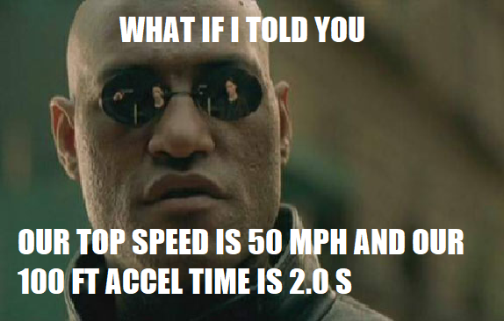
SAE Competitions
All in-person competitions canceled :(
Virtual competitions
Judged on cost, design, and sales
4WD
2022 comps require all 4WD
2021 comps have extra points (like 2020 would have had)
What we’re still wondering about
Value of cash prizes??
How we’re presenting things??
Where did our money go!?

Slide 7

What Could Have Been
Arizona S&T
Arizona Maneuv

Slide 8
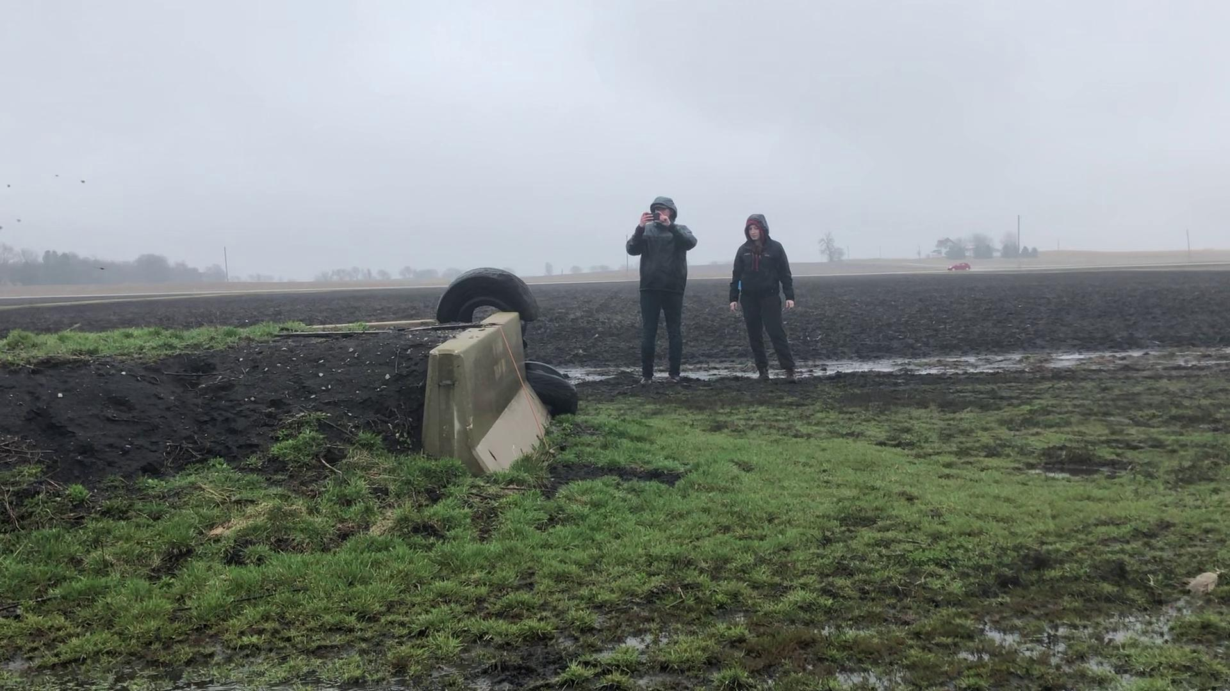
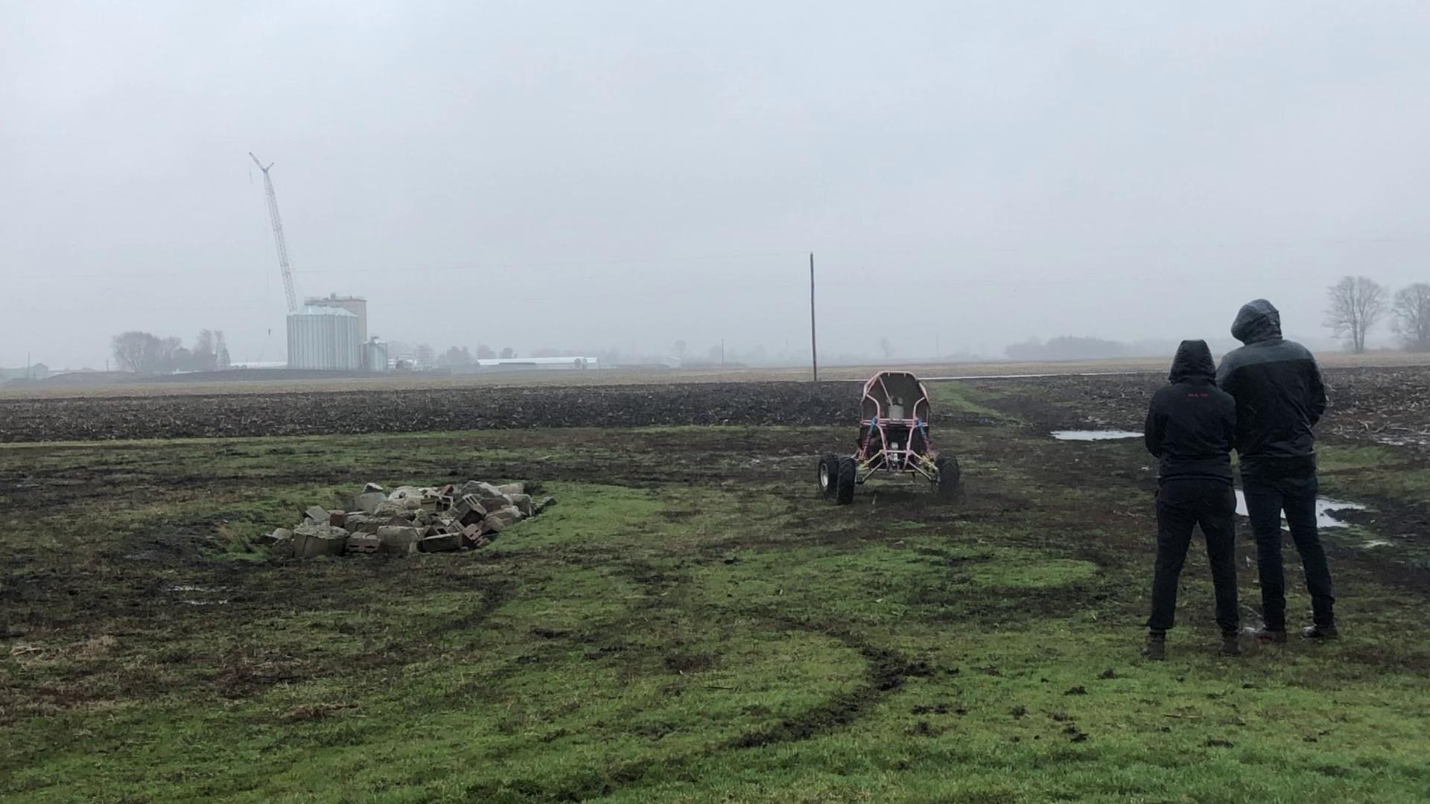
Spring Break Testing
Slightly damp

Slide 9
Unofficial Competion (Maybe)
After the virus has calmed down
Trying to host it at MTRA in early July - Bixby Missouri
“Midwest Madness”
Currently talking to Dustin (alum) about potential plans
2 day competition (Tech day and endurance day)
Camping for teams
Unsure what teams would come
Gauging interest on the Baja subreddit

Slide 10
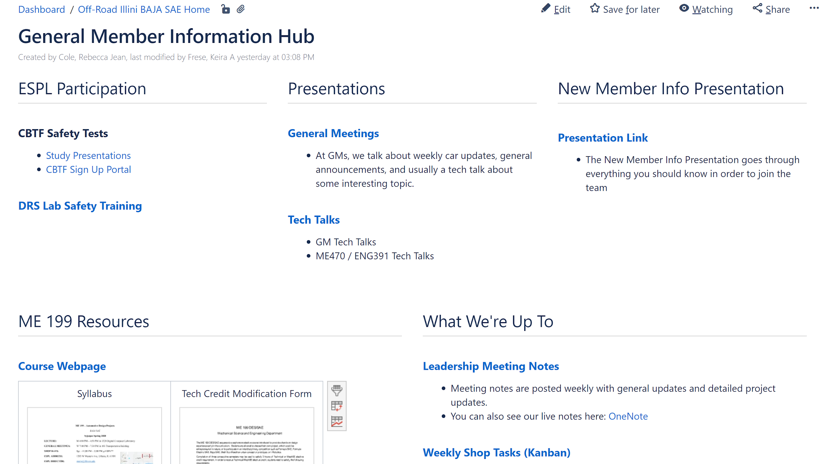
Wiki Changes
New page for all general member information
Including team google calendar
Could be easier to find than the OneNote
Different organization in sub-team tabs
Project pages/descriptions
Go check it out!

Slide 11
Subteam Updates

Slide 12
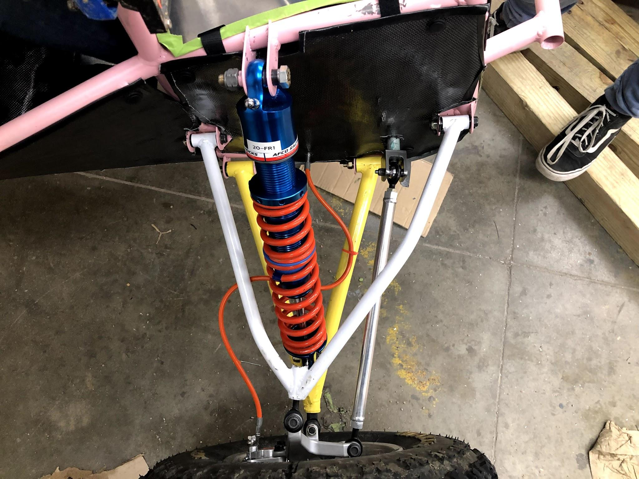
Suspension
TBD (See Slack channel)
Zoom Meeting
A-Arm iteration 2 fully completed before break
Fixed all collision issues
18.5 inches of ground clearance at frame!
199 moving forward
Wrap up of spring projects being discussed at subteam meeting
Shifting focus to 2021 projects
4WD points well underway

Slide 13
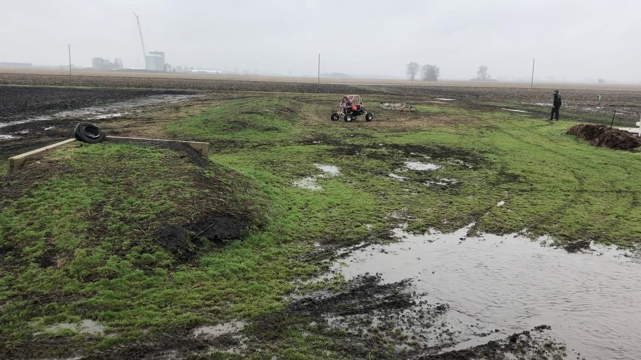
Drivetrain
WEDNESDAYS at 7pm
Zoom Meeting
CVT works but needs tweaking
Belt is sagging
Possibly try lighter weights and stiffer spring
Driveshafts sheared bolts
Looking into future solutions
Working on 4WD plans
Meeting this week to discuss best system
Meeting with Senior Design to discuss projects
Will assign projects to 199 people after all these meetings are finished
Subteam meetings are now WEDNESDAYS 7pm
Notice in the video:
Even without a well-tuned CVT Jill is quicker than Pollock- more torque from gearbox

Slide 14
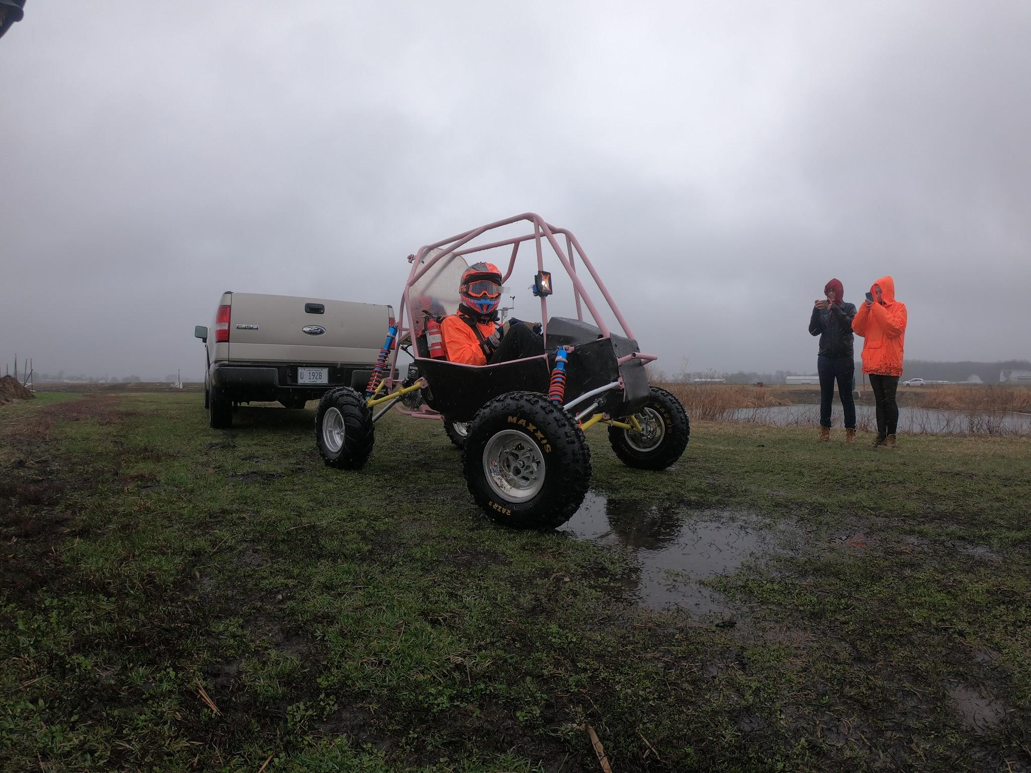
Chassis
Wednesdays at 7pm
Zoom Meeting
Body panels are all carbon fiber where possible
Rear tow hitch is welded
Evaluating each ME 199 project to see if it can still be completed this semester
Projects that can not be completed this semester will be ended, and those people will be assigned to a project for next year’s car

Slide 15
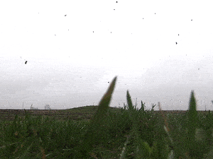
Electronics/Testing
No more meetings
No more meetings
Cooling fan mounted to CVT Case
Off-car testing successful
Unable to mount control electronics before quarantine
Continuing to work on control electronics from home

Slide 16

Business
Tuesdays at 6:30pm
Zoom Meeting
Schlumberger dropped as a sponsor :(
Newsletter is postponed to put in updates abou COVID
Assignments postponed to Friday
Check out the new banner!

Slide 17
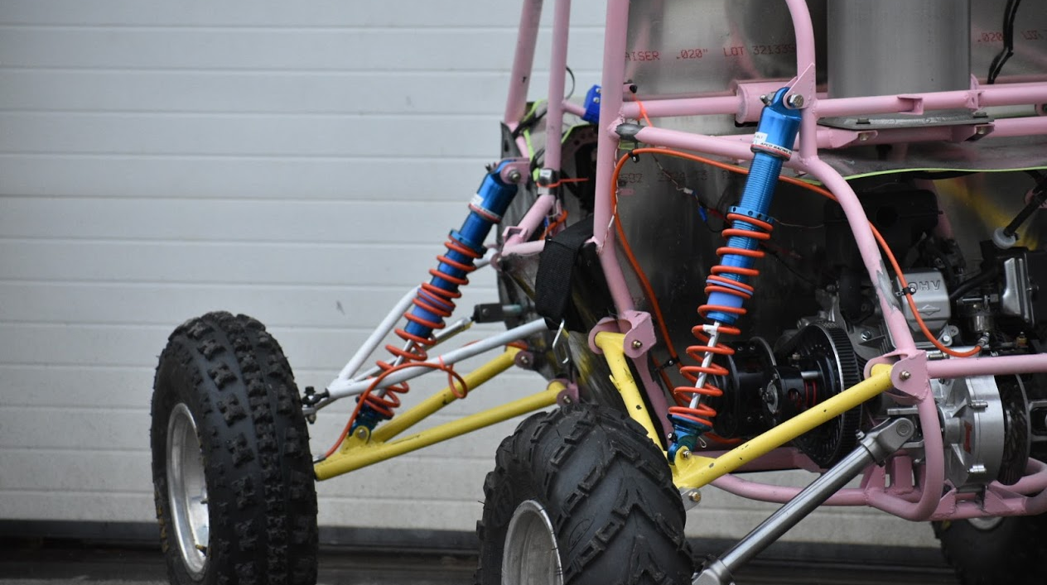
Questions?

Slide 18
Illini Motorsports
ME199
3/23/20

Slide 19
Plan for the Rest of the Year
Physical work has halted on the 2020 car
Design and Cost work will continue
For 199 every member will be expected to make a few slides similar to what you’ll see today
Keep an eye out in the groupchat
Thank you for all your hard work this year!

Slide 20
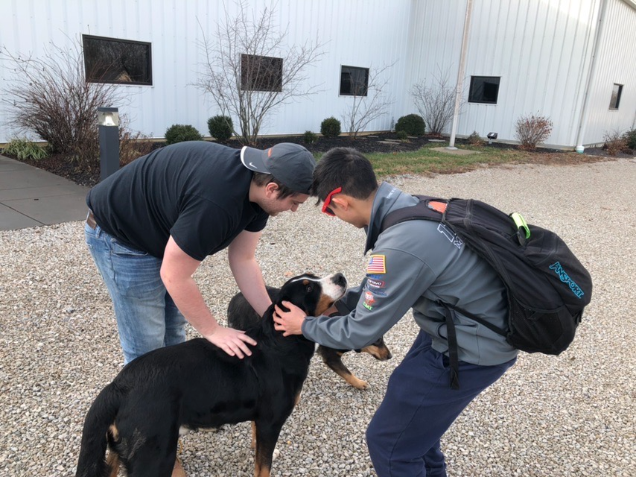
Alex Kirr
Aerospace Engineering 2020
Joined Illini Motorsports in Fall 2017
Involvement
President 2019-2020
Aerodynamics Lead 2018-2019
Aerodynamics Member 2017-2018

Slide 21
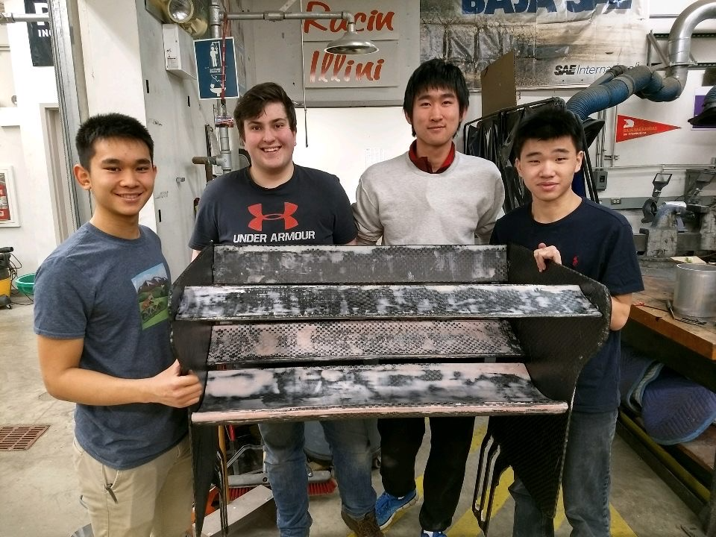
Aerodynamics Member
Sanded
Created mold CAD for RW endplates
Assisted with majority of aero layups
More sanding
Helped write aero design binder

Slide 22
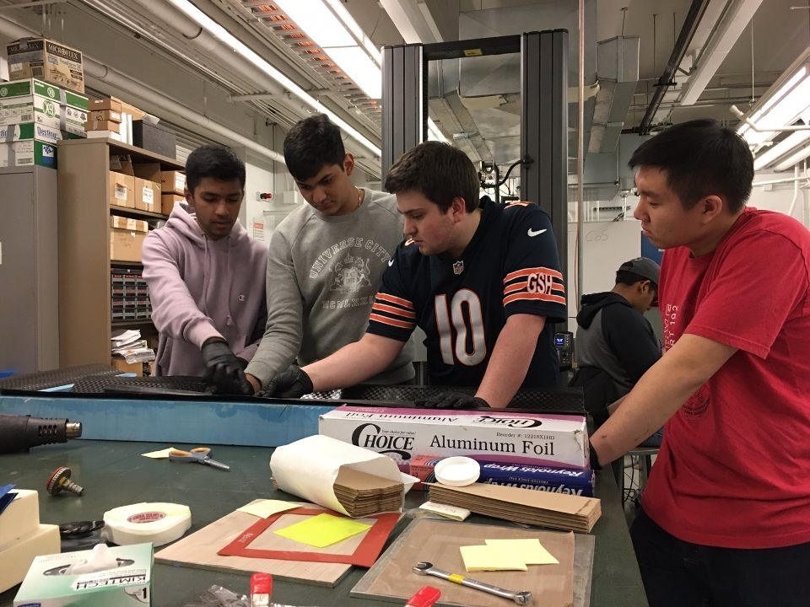
Aerodynamics Lead
Responsible for overall design and manufacturing of aero package
Double biplane RW
Modified FW mounting
More aggressive diffusing angle
Improved nose cone

Slide 23
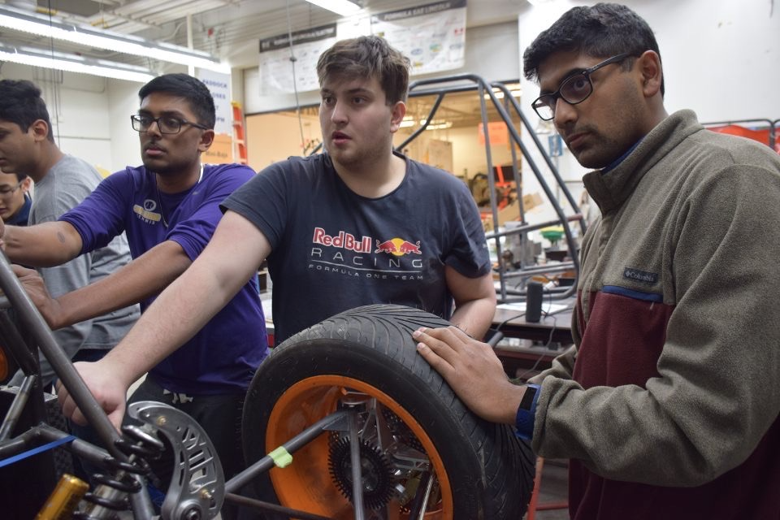
President
Manage team’s finances
Act as external face for the team
Setup outreach
Secure sponsors
Gained a deeper understanding of how business relates to engineering.

Slide 24
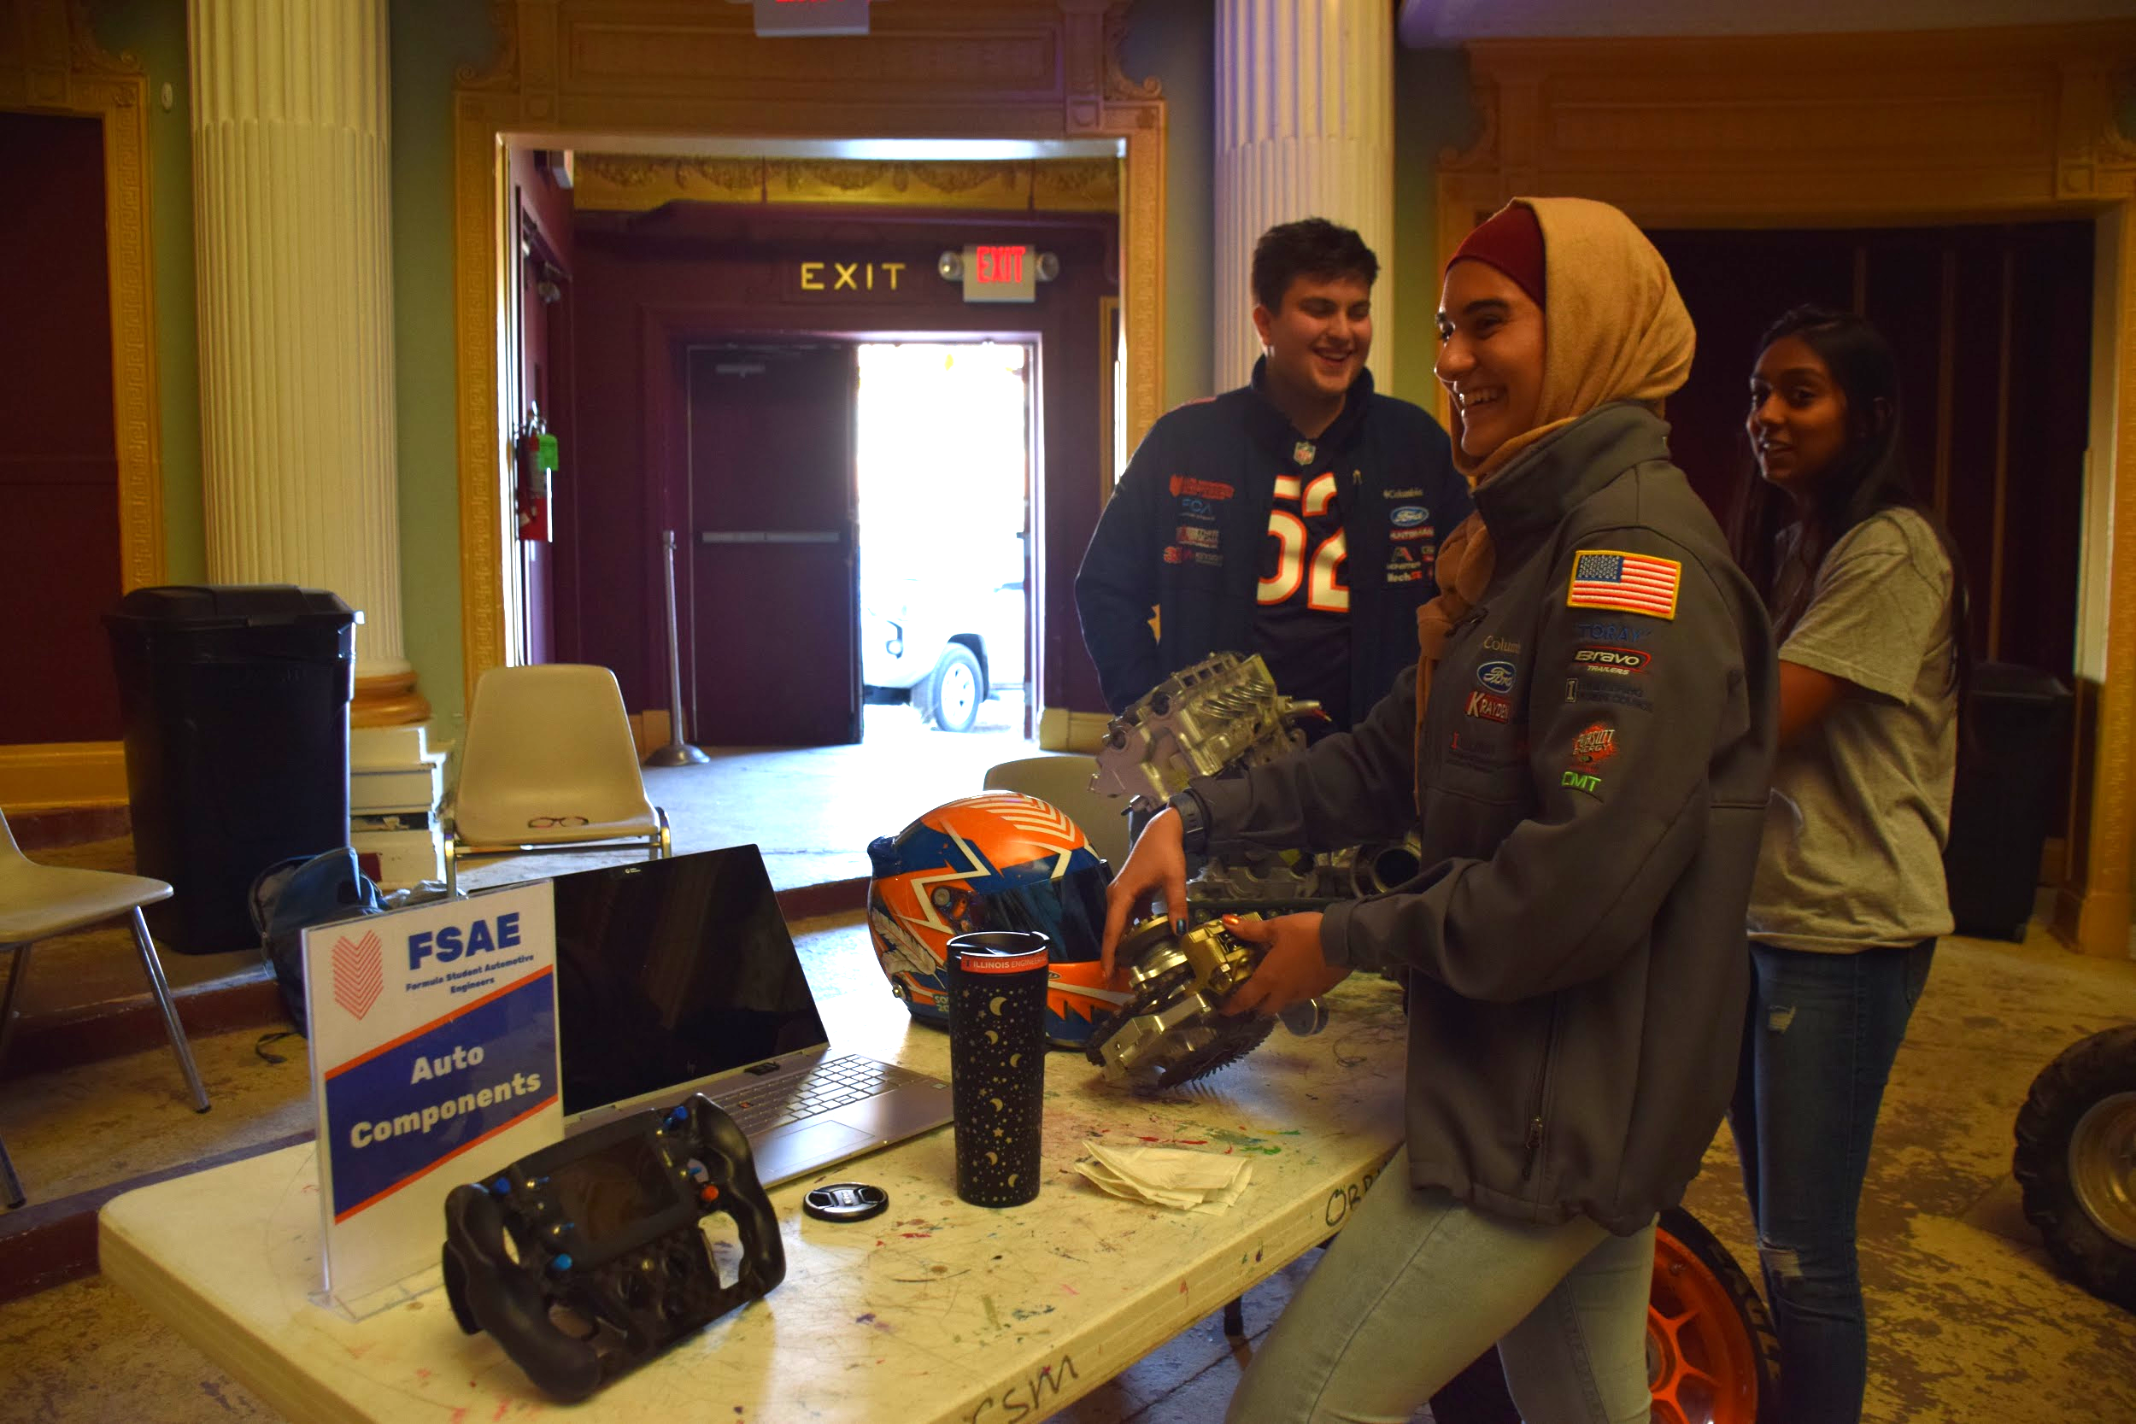
Salam Mulhem
Aerospace Engineering - ‘21
Joined Illini Motorsports in Fall 2019
Cross-Subsystem Member
Aerodynamics
Suspension
Composites
Team & community involvement
Outreach events
Team photography & social media

Slide 25
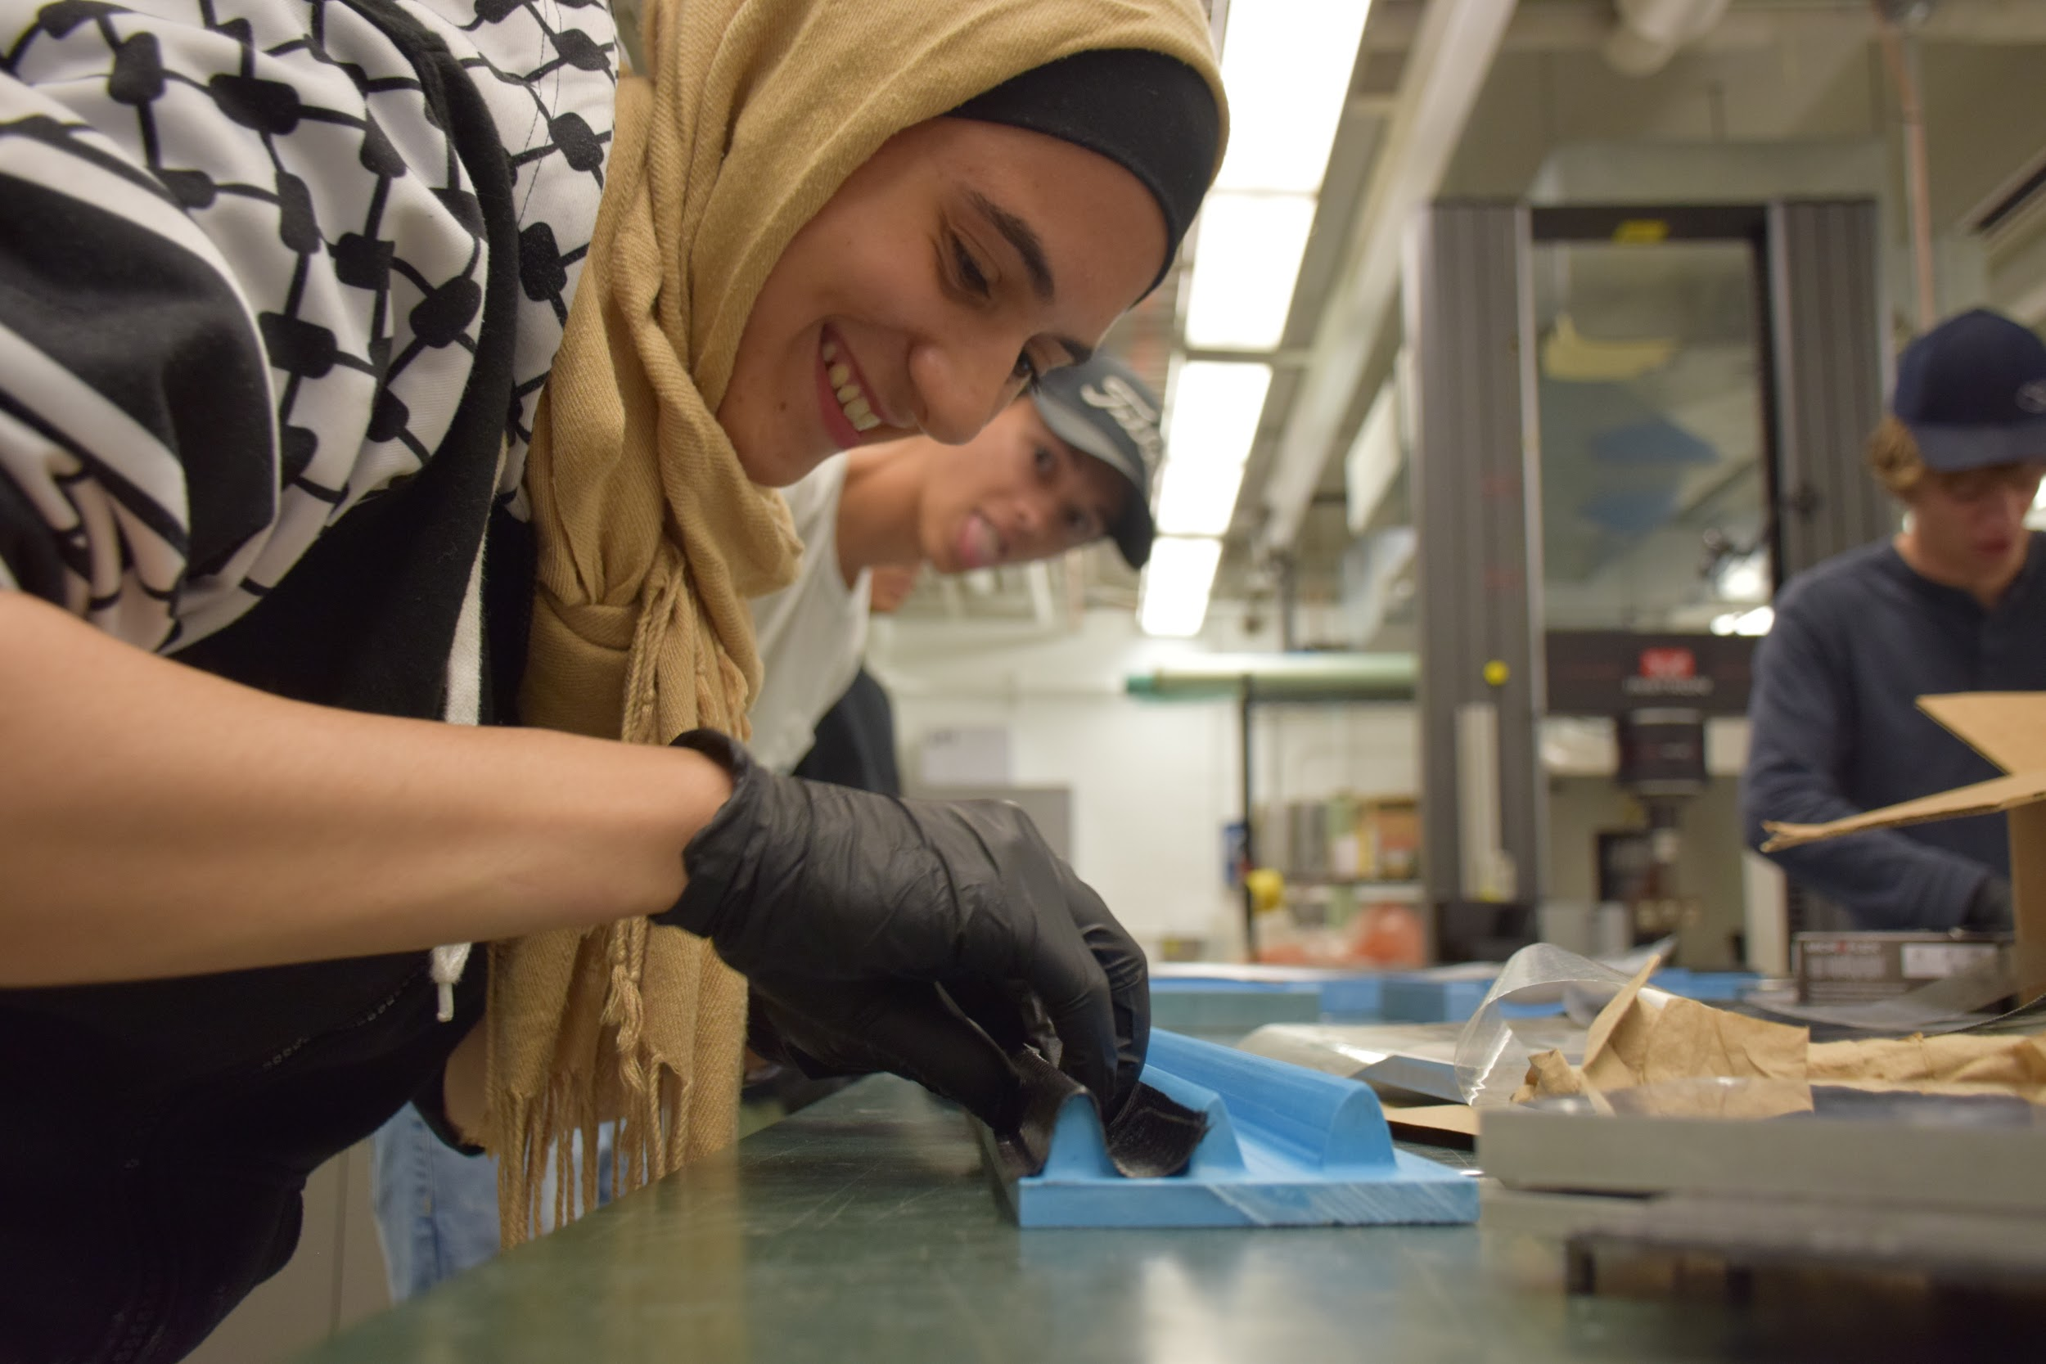
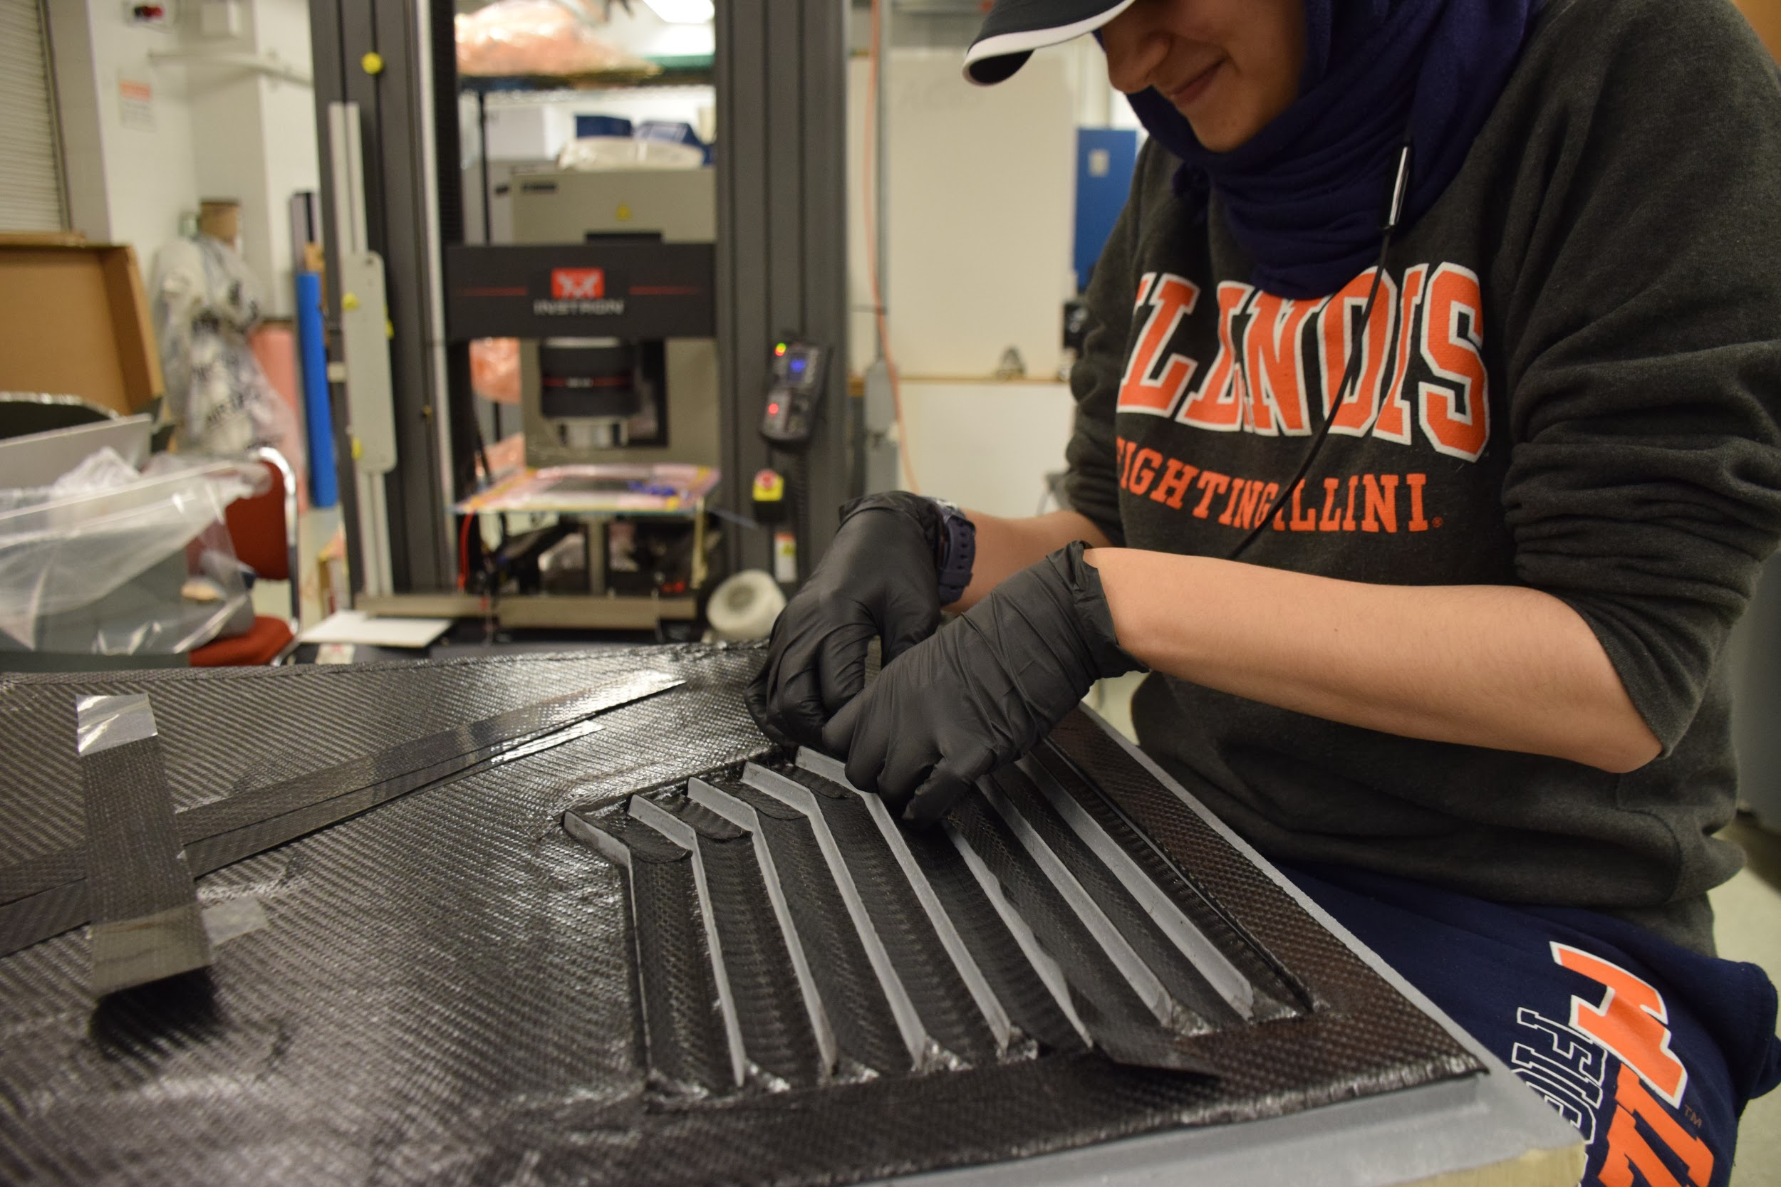
Aerodynamics
Participated in manufacture of large portion of aero package (front & rear wing, e-cover, bullhorns, etc)
Mold prepping
Layups
Post-processing
Learned to manufacture elements with a higher degree of skill and precision, working on increasingly intricate components

Slide 26
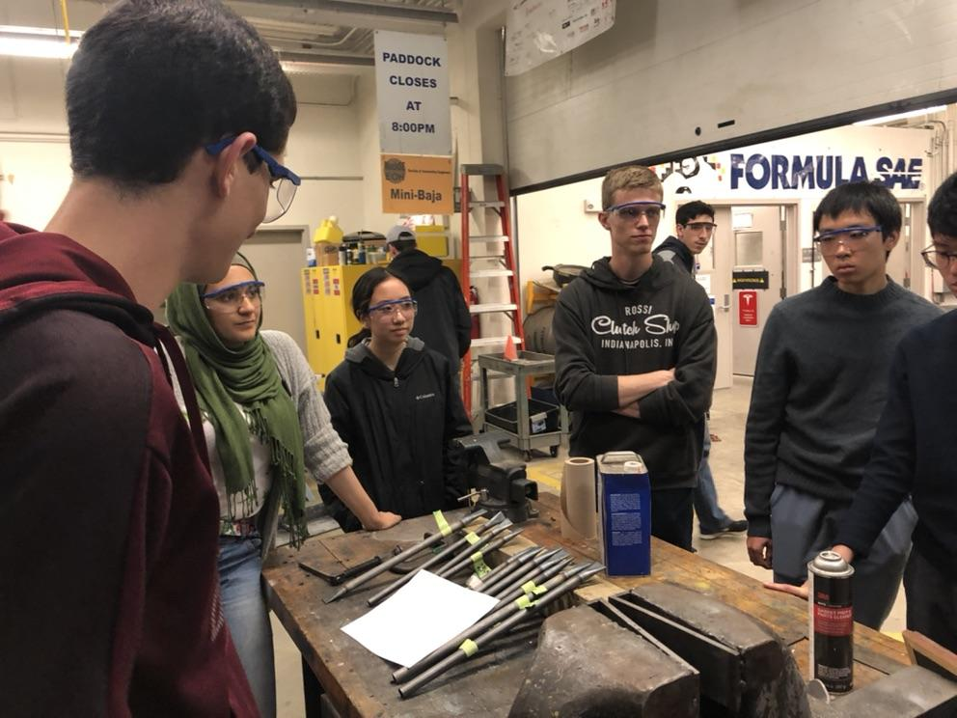
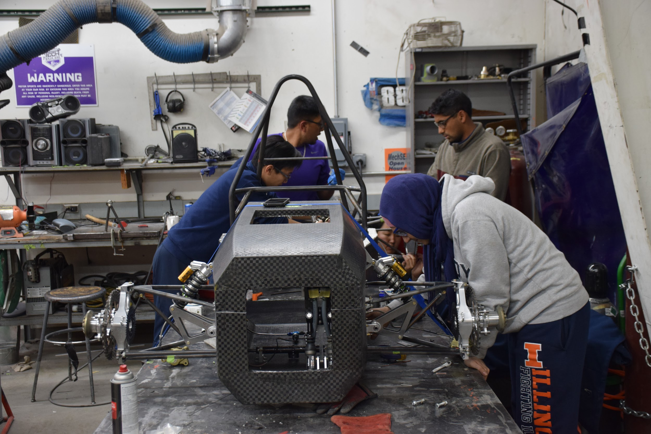
Suspension
A-arm manufacture
Rolling Car assembly
Assisting in strain gauge mounting and setting ride height
Lower aft A-arm mount resizing
Testing/sweeps
Welding and machining training
Gained deeper understanding of vehicle dynamics and suspension assembly

Slide 27
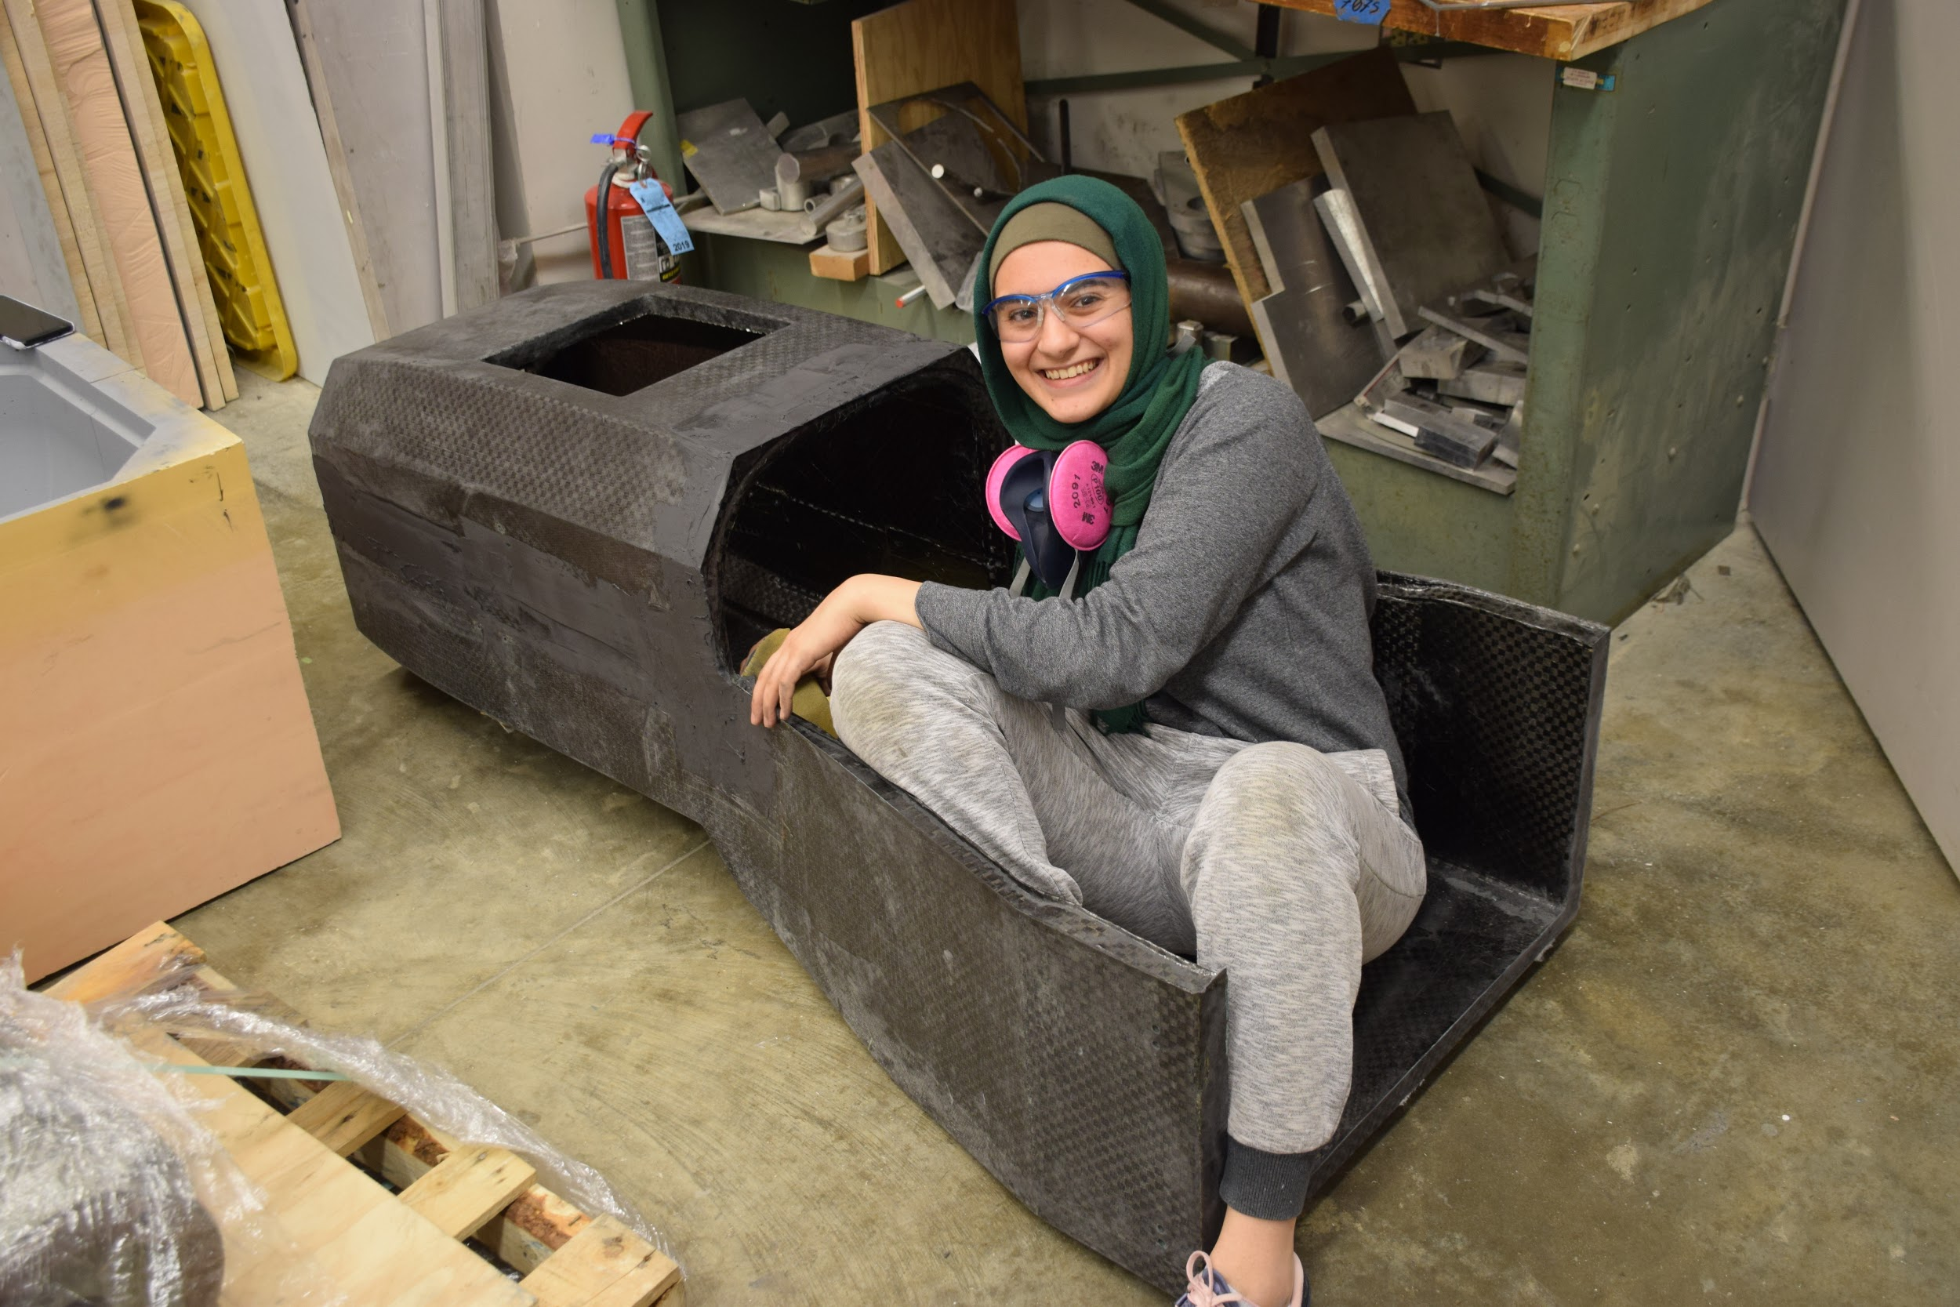
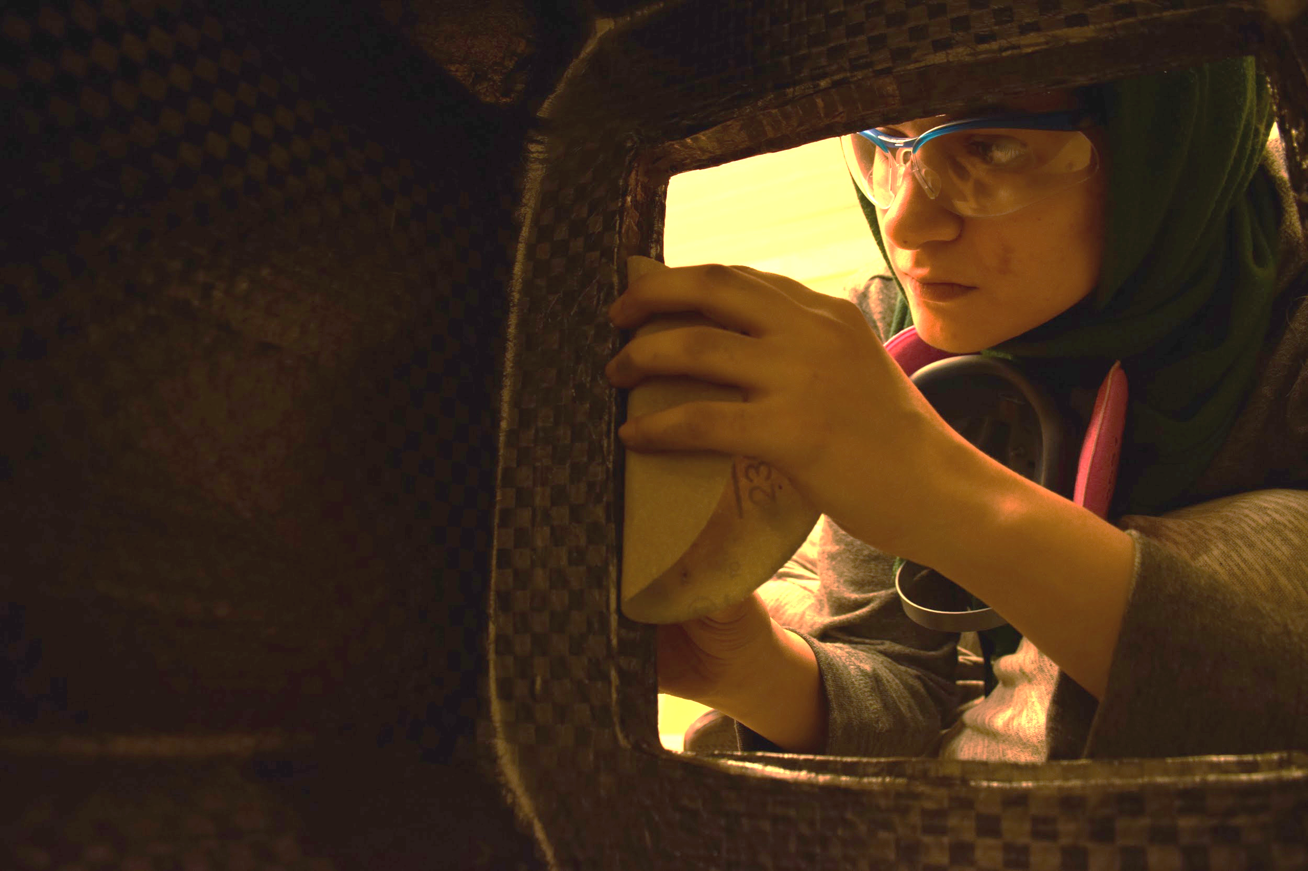
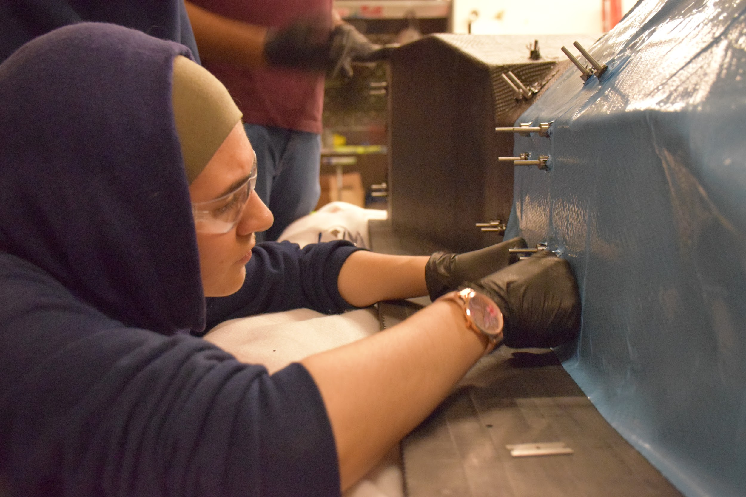
Composites
Held heavy responsibility in preparing monocoque molds
Participated in layups and post-processing of monocoque
Participated in layups of composite test panels and coupons

Slide 28
What I’ve Learned from Formula SAE
- Stephen Bosch
ME199
3/9/2020

Slide 29
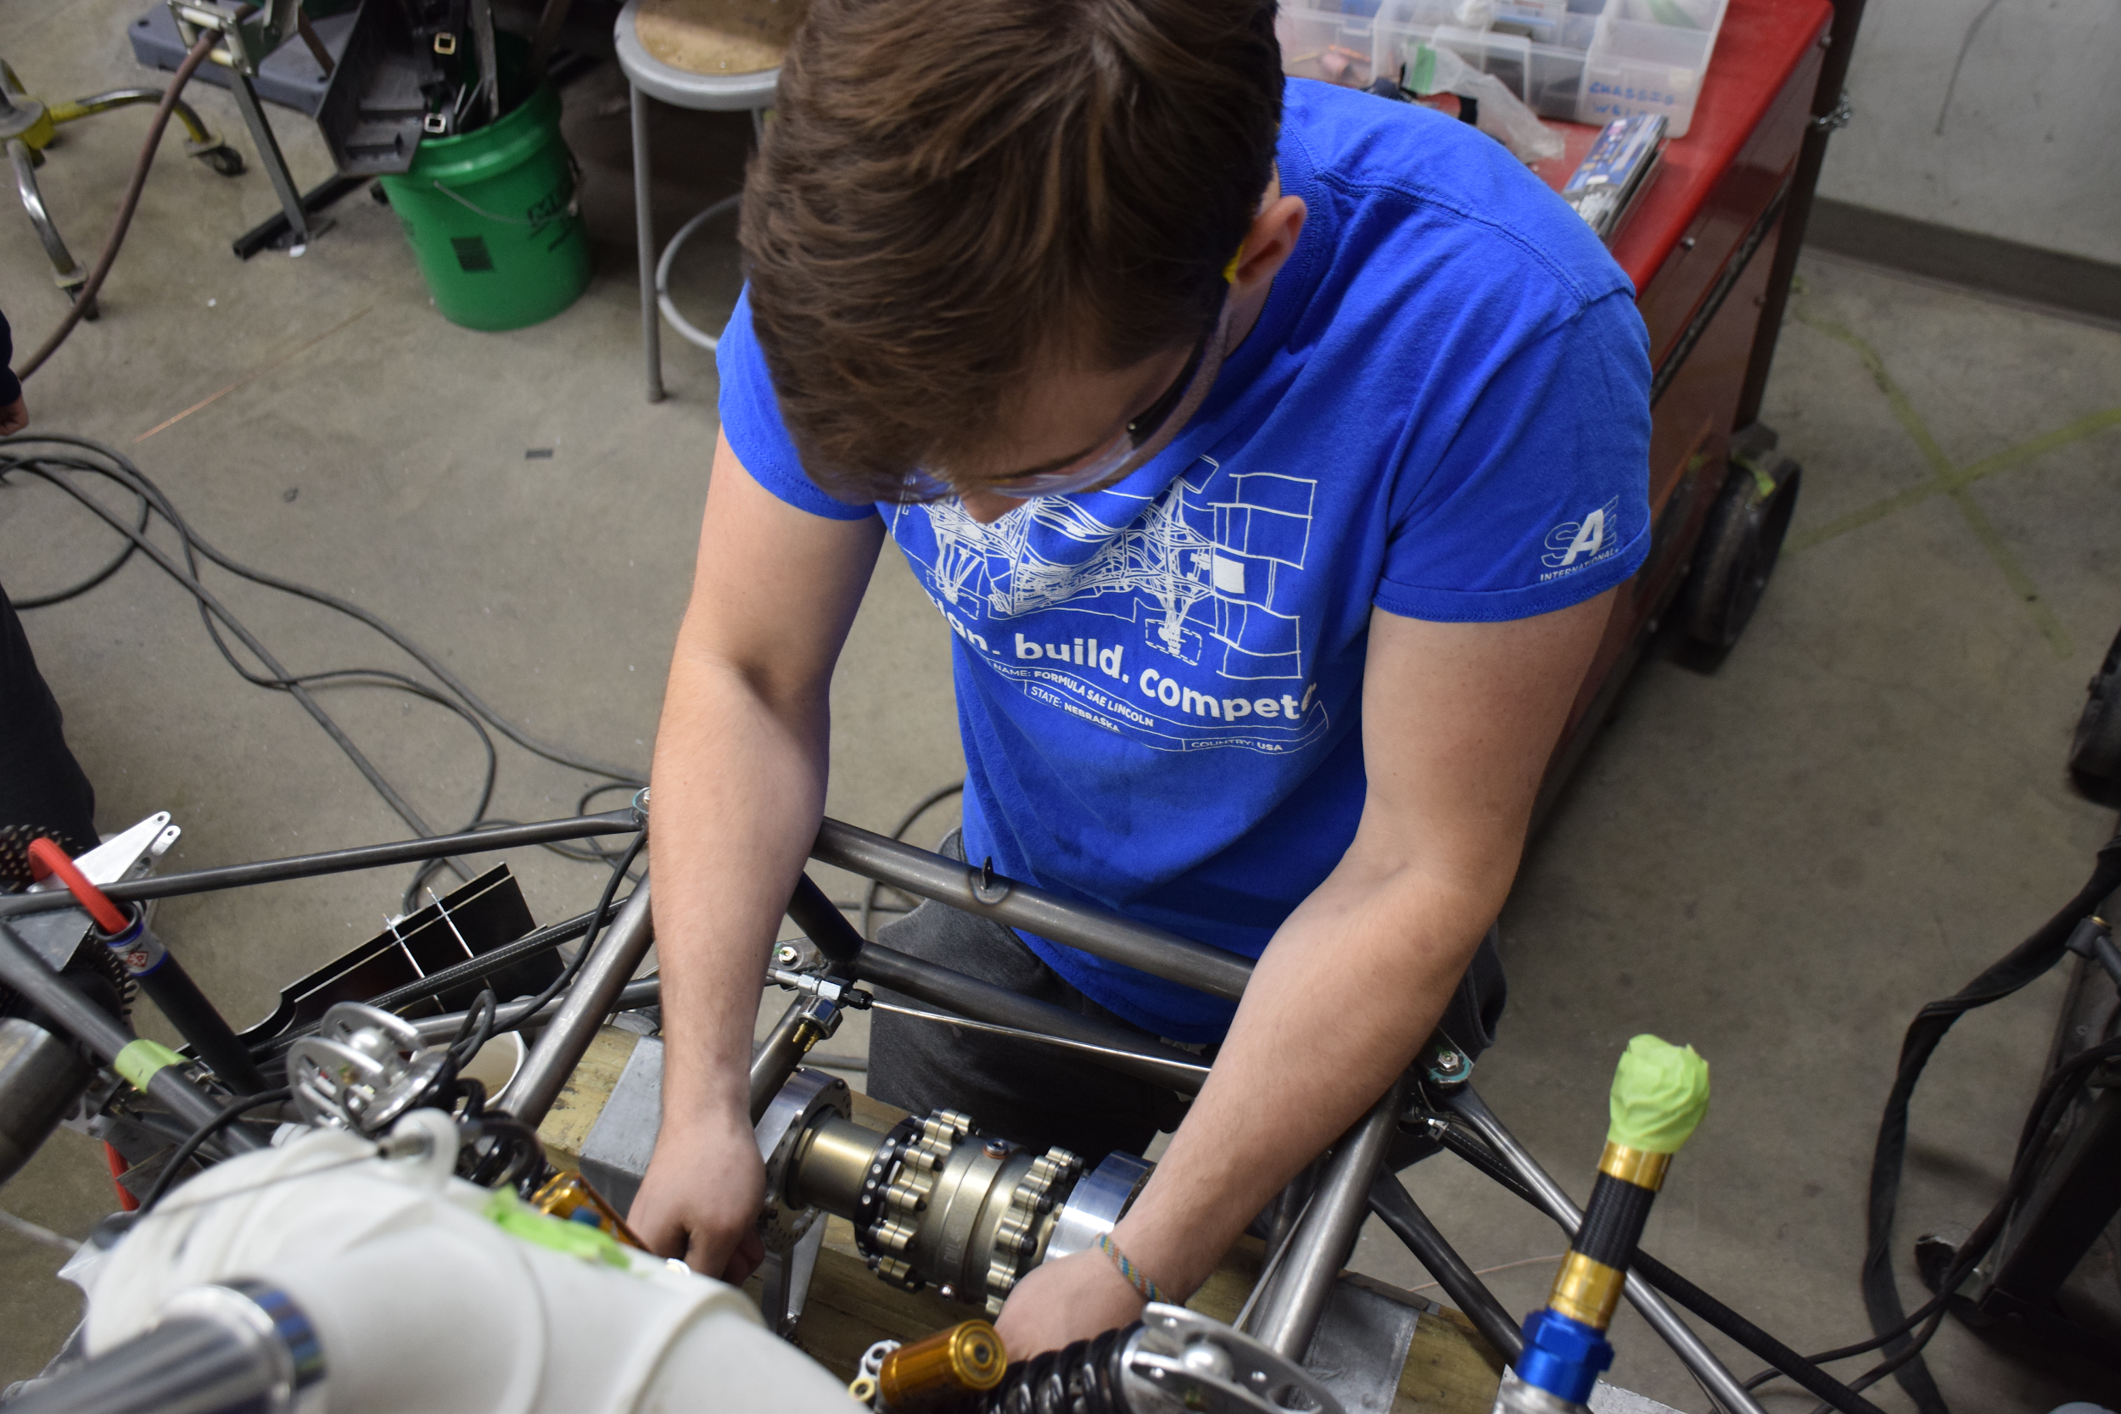
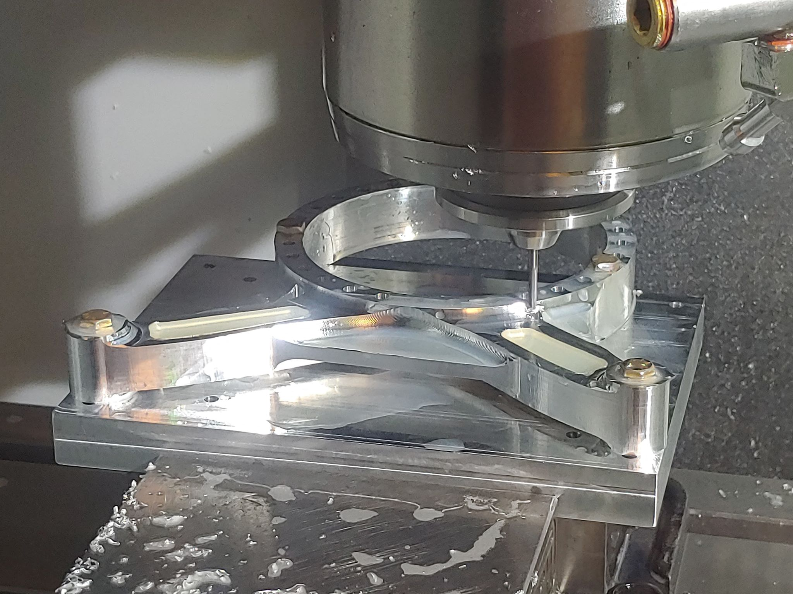
Technical Skills
Software skills (Matlab, CAD, Ansys,
Engineering communication
Ability to deliver technical presentations
Manufacturing
Manual and CNC machining, composites, etc.
Beyond the classroom education

Slide 30
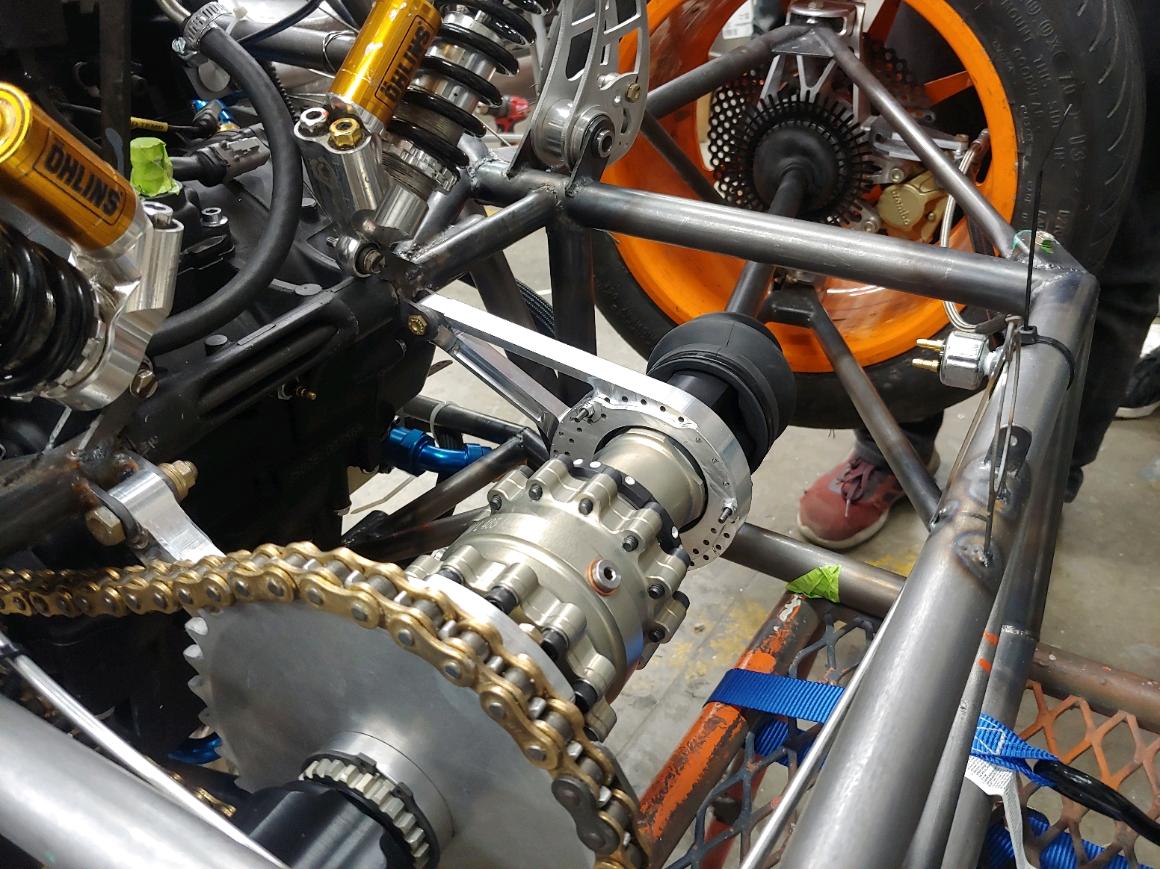
Design Projects
Vehicle system level design
Rear driveline redesign
Final drive analysis
Brake dynamometer work
Most importantly, I’ve learned how exciting engineering can be!

Slide 31
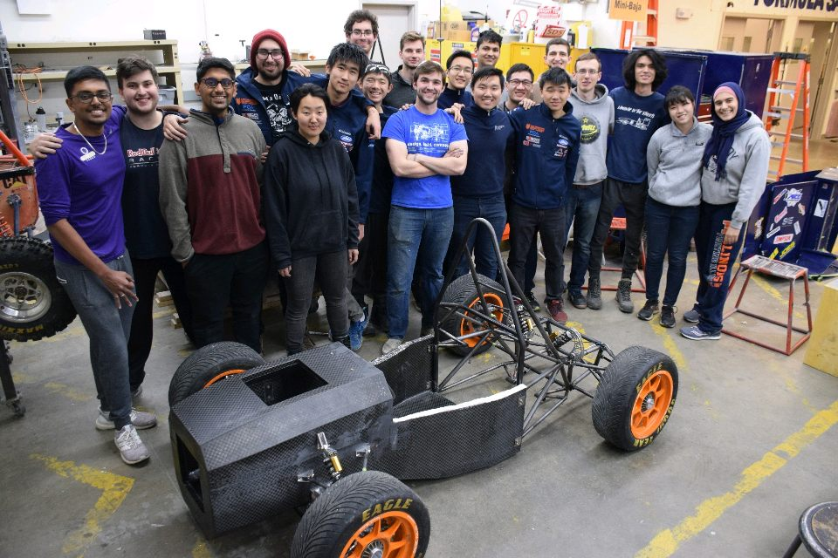
Teamwork and Leadership
I’ve been privileged to work alongside some of the most talented and riven engineers at Illinois
Practiced working with a diverse team to tackle incredible engineering challenges

Slide 32
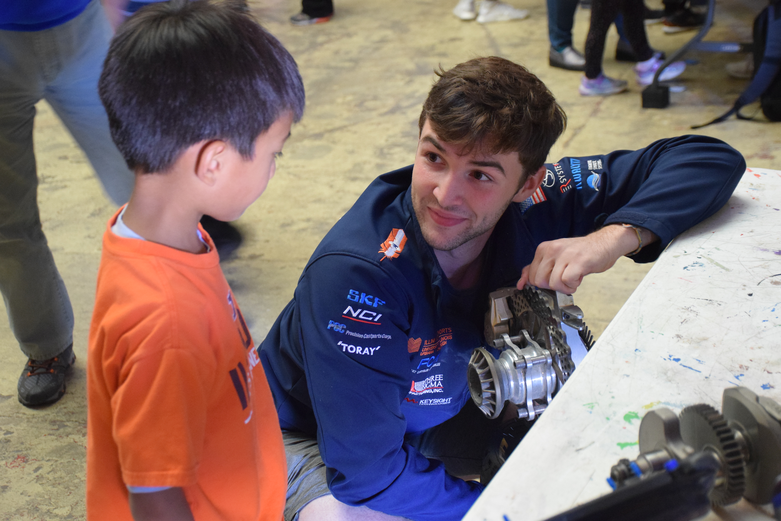
Outreach
Illini Motorsports has been a fantastic outreach opportunity!
EOH, Orpheum, Flying S, etc.

Slide 33
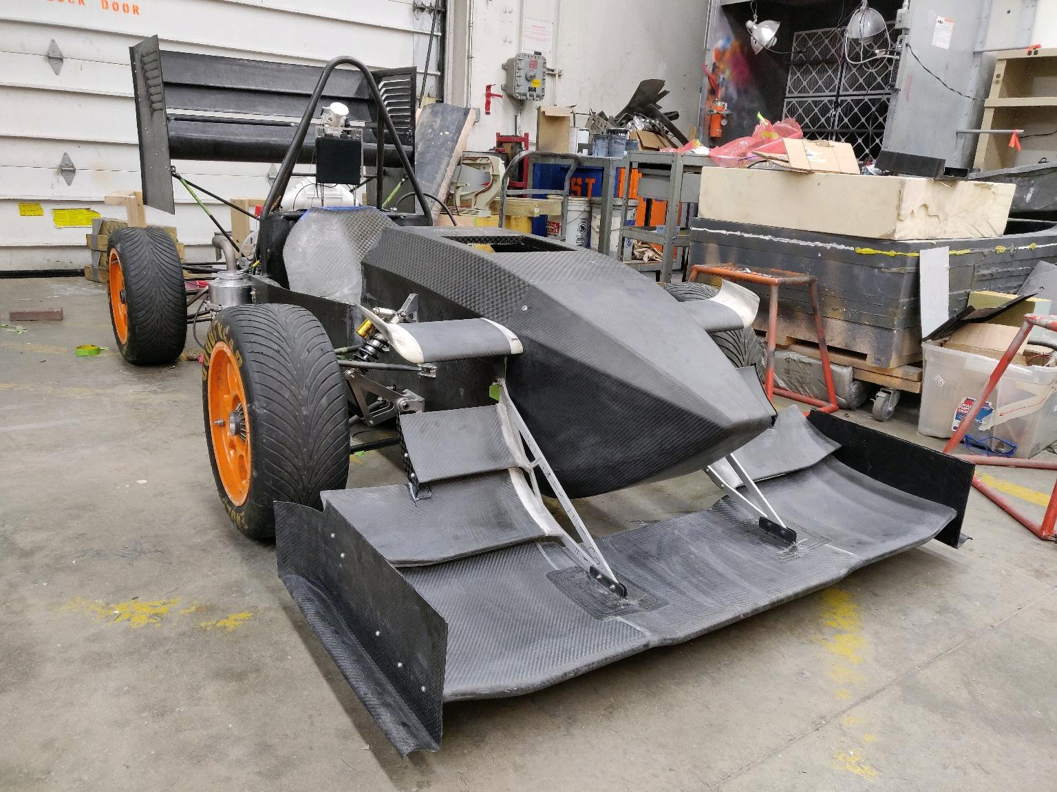
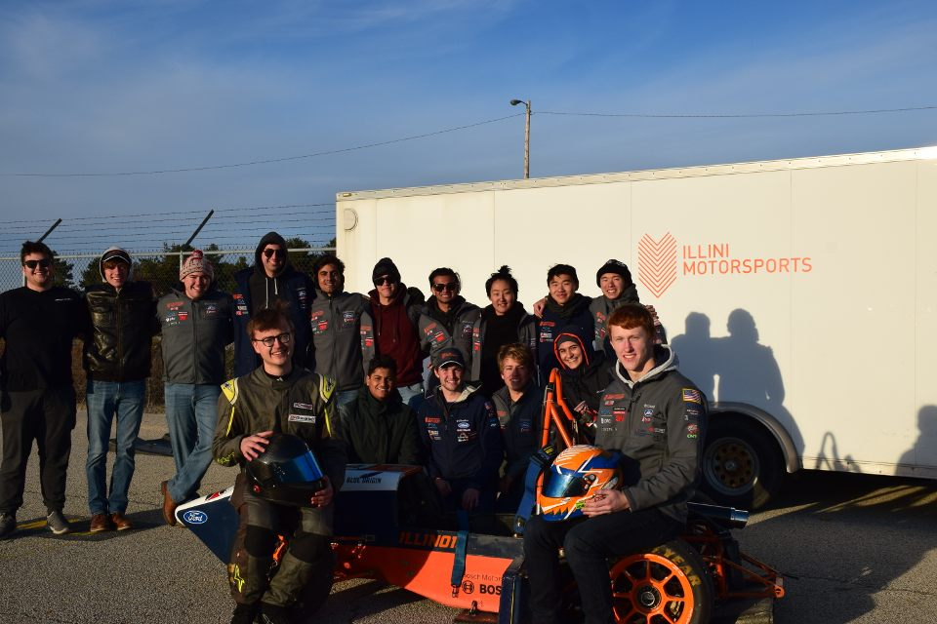
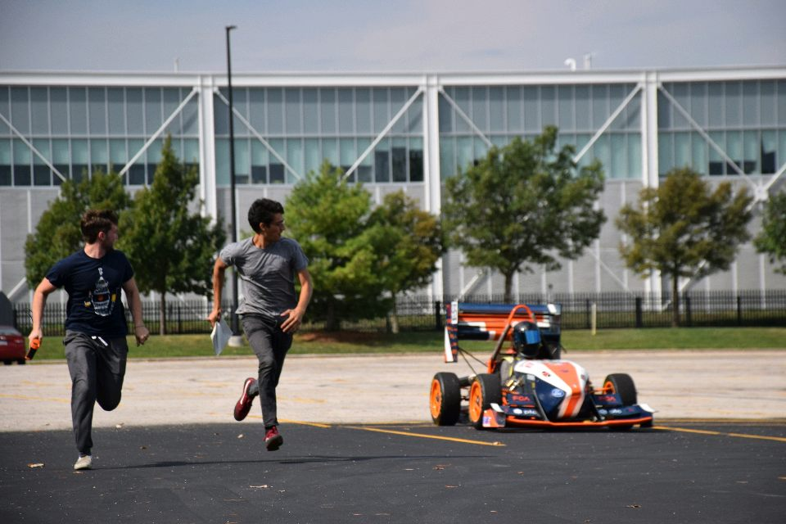
Illini Motorsports has made me the person I am today.

Slide 34
ME 199
3.23.20

Slide 35
General Updates
FCA Test and Tune in April is cancelled
FSAE California has moved to virtual events for the static and cancelled the dynamic
Team leads will deal with preparing the team for this
We are going back to design work for the rest of the semester
New leadership will handle the start of 4WD design

Slide 36
Subsystem Meeting Times
General: Cancelled
Chassis/Suspension: Cancelled
Drivetrain: Cancelled
Aerodynamics: Cancelled ​
Tractive: Cancelled
DAQA: Cancelled
Mattermost channels will be up to date with any virtual meetings that take place!

Slide 37

MECHANICAL
CHASSIS
SUSPENSION
AERODYNAMICS
DRIVETRAIN

Slide 38
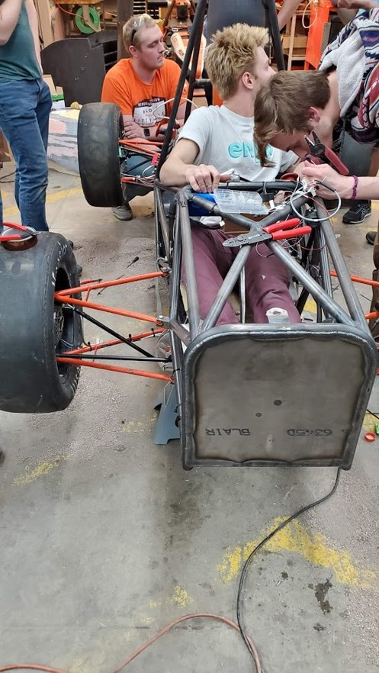
Chassis/Suspension
Henry Steenkolk –
steenko2@Illinois.edu
Last Week
Cleaned up the shop and closed down ESPL
This Week
Documentation of Artemis design work
Start 2021 design work
Analyze TTC data and make magic formulas

Slide 39
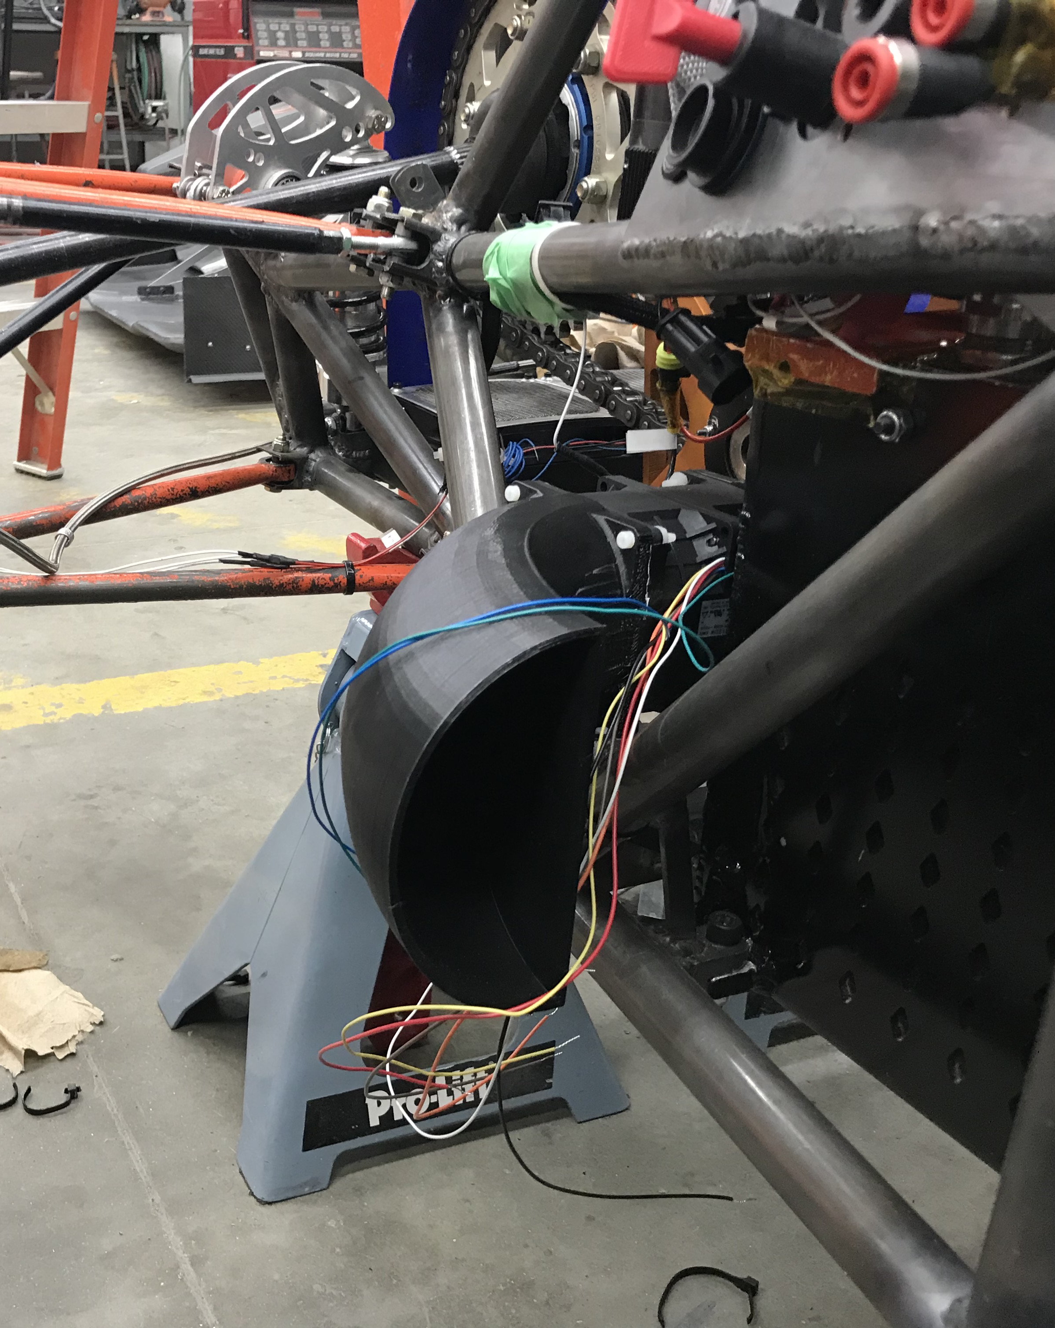
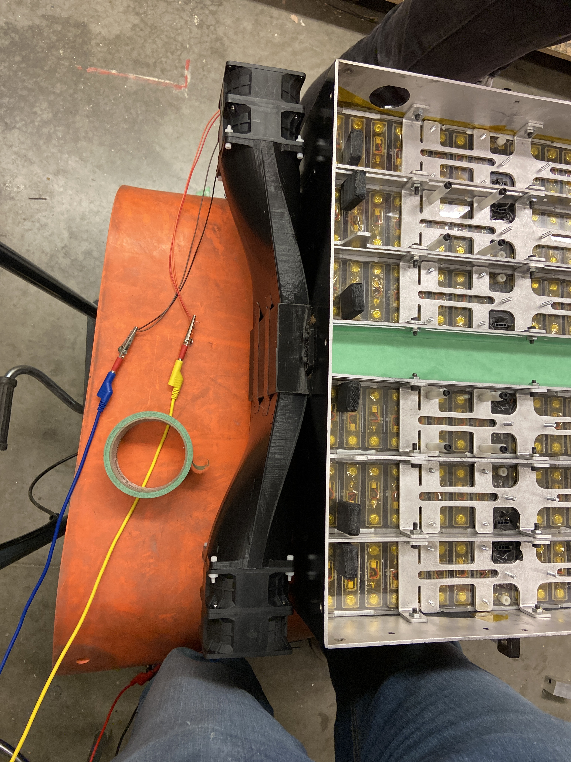
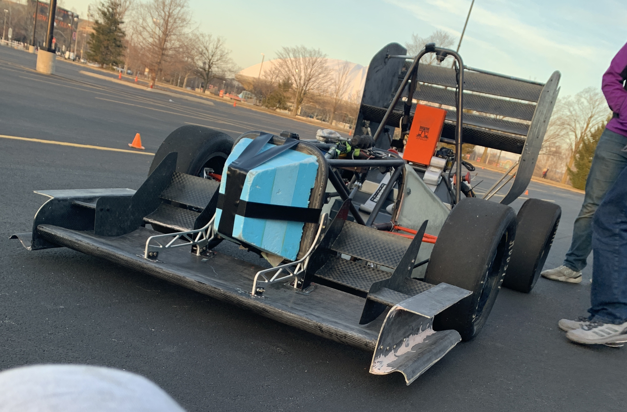
Aerodynamics
Ben Schultz –
bks4@Illinois.edu
Last Week
Printed cooling ducts
Adjusted mounting of wings for stability and rules
This Week
Condense Artemis documentation
Begin design work for 2021

Slide 40
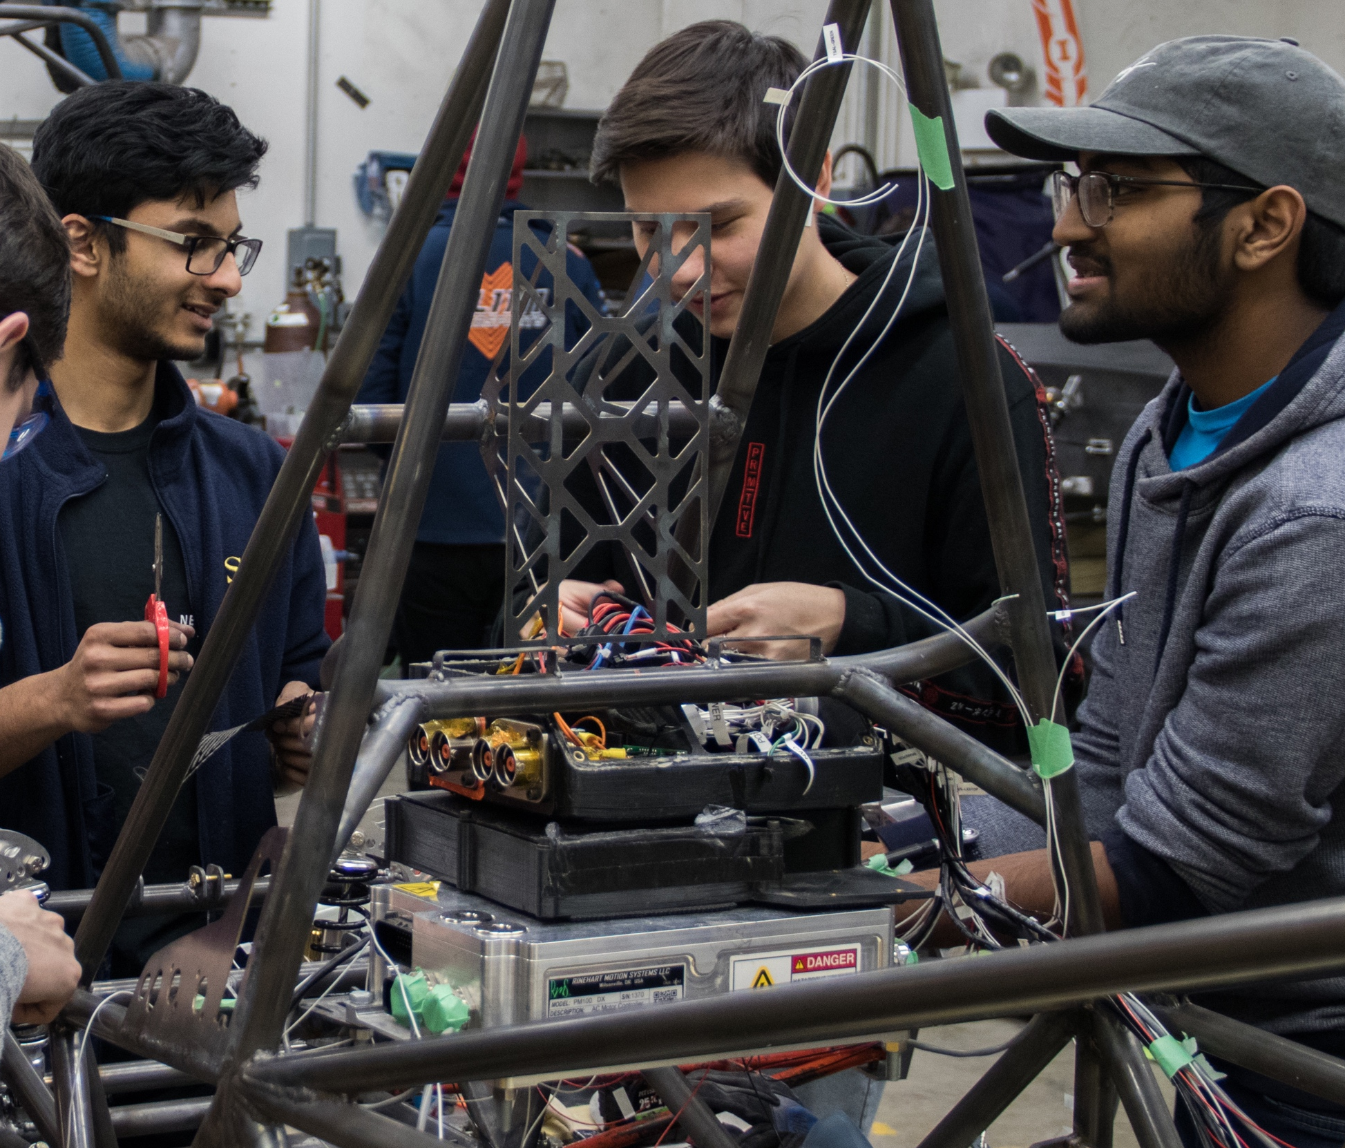
Drivetrain
David Lam
wj6@Illinois.edu
Last Week
Worked on OZ wheel mounting CAD
This Week
Condense Artemis documentation
Begin work on 4WD

Slide 41


ELECTRICAL
TRACTIVE
DAQA

Slide 42
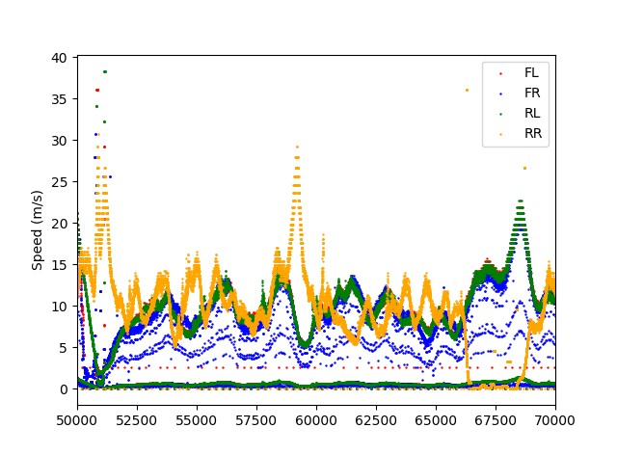
Tractive
Evan Chen –
evanc4@Illinois.edu
Eddy Liu –
jiayuan5@Illinois.edu
Last Week
2021 research
Team documentation
Analyze testing data
This Week
2021 research/design

Slide 43
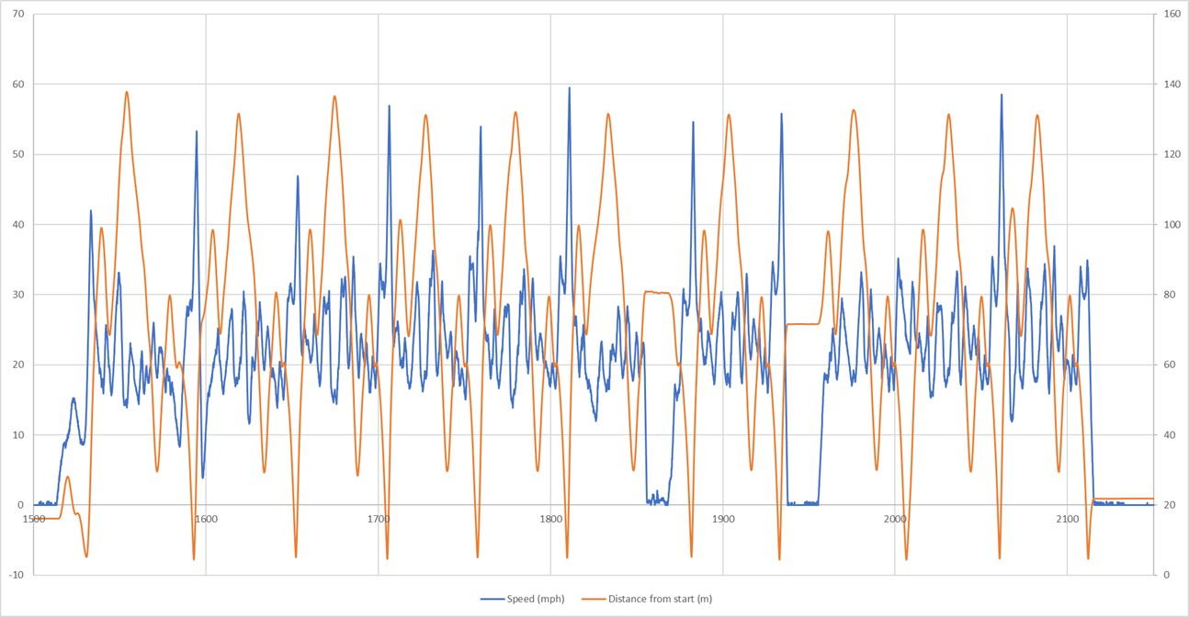
DAQA
Joe Lopez –
joseal2@Illinois.edu
Last Week
Made changes to GPS and switched timestamping method
This Week
Documentation of design
Board redesign

Slide 44
BUSINESS

Slide 45
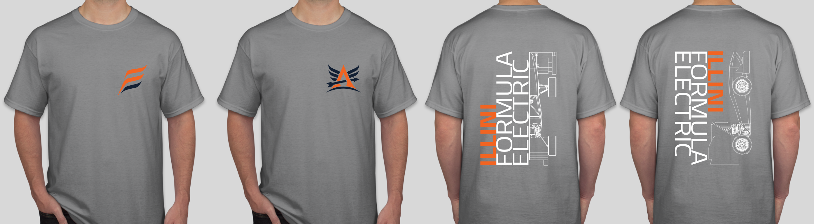
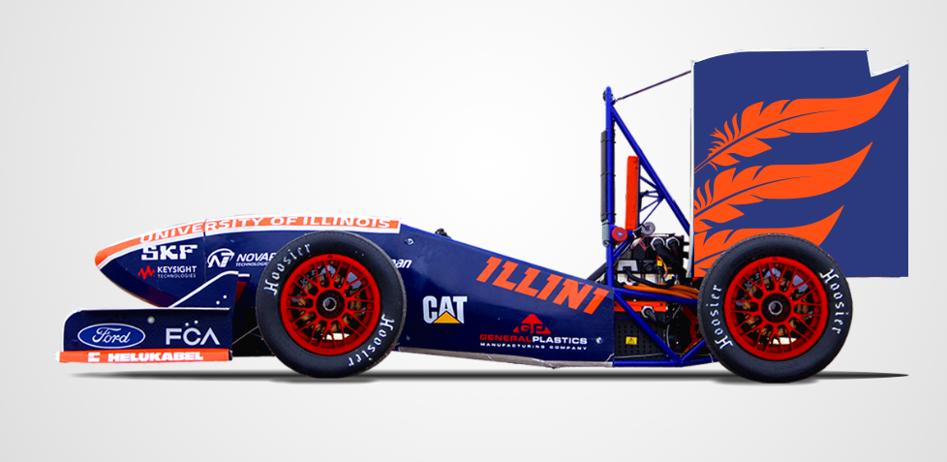
Business
Kush Patel –
kushrp2@Illinois.edu
David Lam –
wj6@Illinois.edu
Last Week
Adjusted t-shirt designs
This Week
Finalize business presentation plan
Begin research for business presentation
Begin making business presentation slides

Slide 46
QUESTIONS?

